Slide 1
VSC HPC Introduction
ICTS KU Leuven VSC staff: Ehsan Moravveji Mag Selwa Geert Jan Bex (Uhasselt) Jan Ooghe Wouter van Assche

Slide 2

Questions and problems troubleshooting
Blackboard Collaborate session: https://eu.bbcollab.com/guest/ce4229a2f9eb4cc5b90f490d660eb1c2

Slide 3

Material
Everything is on Github: https://hpcleuven.github.io/HPC-intro/
Video Recordings - Scan the QR code - Recommended videos: ~ 2 hrs - Optional videos: ~1 hr

Slide 4

What is High Performance Computing?
using supercomputers to solve advanced computation problems
Reduce the computation time from days, years, decades, or centuries to minutes, hours, days, or weeks
The key is parallelism
Notes:
HPC is about techniques of boosting the efficiency of your codes and computation to enhance the compute performance as compared with a similar workflow on a typical laptop or workstation.

Slide 5

In practice, it is more like …
The concept is simple: Parallelism = employing multiple processors for a single problem
Notes:
In practice, there is a pool of computing resources made available to you which are waiting to receive instructions from the user. The nodes are all inter-connected, which means you can employ more than one node in a specific compute task, and the nodes within the task can communicate with one another at runtime, whenever needed.

Slide 6

Outline
What is the VSC?
What is a cluster?
Genius Cluster
Storage
Login nodes & MFA
Connection Setup
Software environment
How to submit jobs?
Dedicated hardware
How to choose resources?
Optional material - Linux in brief - Conda for Python and R - Worker Framework

Slide 7

VSC (Vlaams Supercomputer Centrum)

Slide 8




















VSC PARTNERSHIP
A n t w e r p e n
O o s t
V l a a n d e r e n
Supported by
W e s t
V l a a n d e r e n
L i m b u r g
V l a a m s - B r a b a n t
B r u s s e l
vscentrum.be
Notes:
VSC is a partnership between 5 major universities and associations in Flanders, namely … and is spread among 4 sites. VSC is sponsored by the flemish research organization FWO. The idea is that the academics (scientists, students) and industrial partners in Flanders have an easy access to compute and storage facilities. Hence any individual with a single VSC account is eligible to compute on any cluster/site that he/she deires

Slide 9




VSC history
First Global
Funding Collaboration
2nd Flemish
Tier-1 “BrENIAC”
Extending Tier-1 “BrENIAC”
1st Flemish
Tier-1 “Muk”
2007
2012
2016
2019
2009
2013
2018
Official launch
of VSC
Structural
Funding
Tier-2
Funding Tier-1 Platform
Notes:
2007: the first idea sparkled
2009: VSC was officially launched
2012: The first Tier-1 machine kicked into production
2013: VSC receives structural funding from government (will be there)
2016: 2nd Tier-1 machine was launched in Leuven
2018: Government funding for a Tier-1 platform (compute, storage, cloud)
2019: Tier-1 is doubled in size

Slide 10







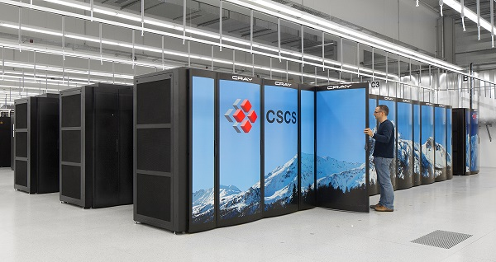


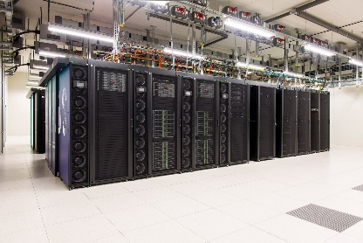





VSC HPC Environments
Tier-0
Tier-1
Hortense
Tier-2
STEVIN | HYDRA | HOPPER/LEIBNIZ | GENIUS/WICE
Notes:
All VSC users can use Tier-2 clusters from any site they desire.
If you still require more compute resources which does not fit into available Tier-2 limits, you can apply for Tier-1 compute time.
Even if Tier-1 level is insufficient, you can apply for Tier-0 level where Belgium is also part of a European consortium.

Slide 11

www.vscentrum.be
Documentation! Answers >80% of your questions
Very rich suite of courses every academic year

Slide 12
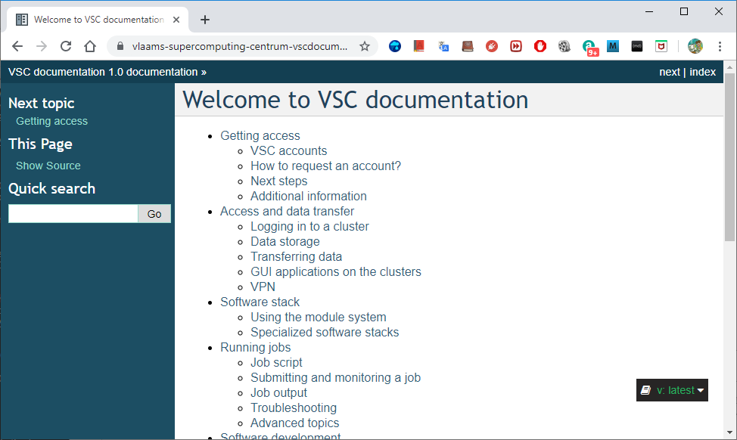
Search you keywords here; e.g. qsub
Notes:
All items are indexed
There is a power search engine there.
Just put a keyword there.

Slide 13
Support and Services
Basic support
Helpdesk (hpcinfo@kuleuven.be)
Monitoring and reporting
Application support
Installation and porting
Optimisation and debugging
Benchmarking
Workflows and best practices
Training
Documentation and tutorials
Scheduled trainings / workshops
On request workshops
One-to-one sessions

Slide 14
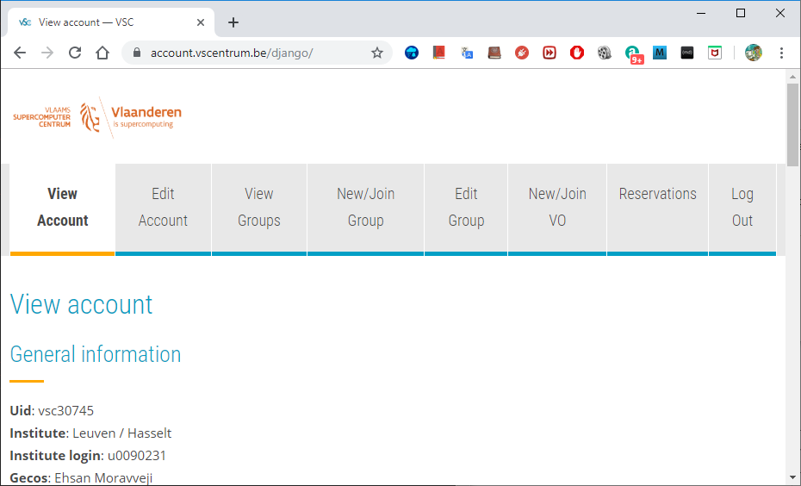
To manage your VSC account: account.vscentrum.be
Upload more SSH public keys
Upload SSH Key Request account
Create or request to join a new group
Moderate your own groups (add/remove users)

Slide 15
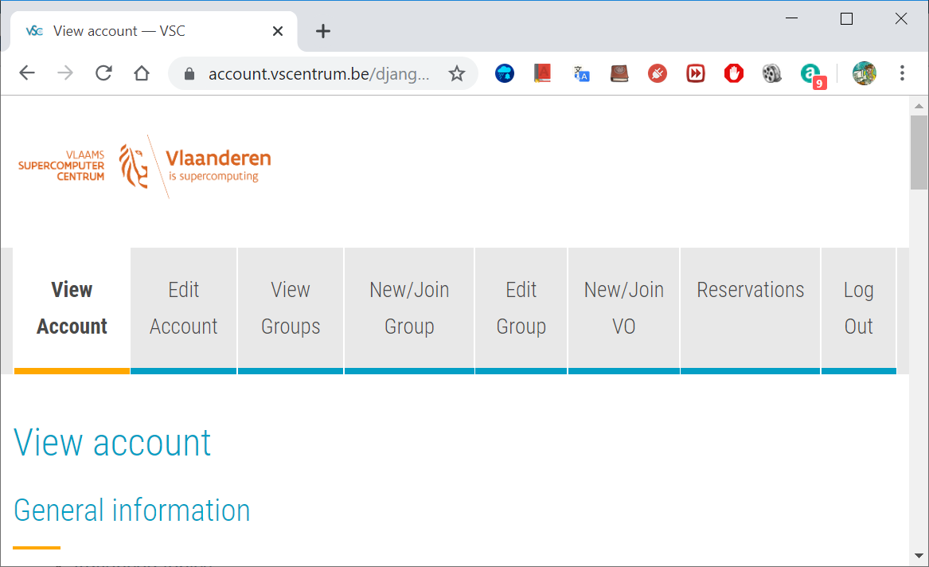

Become a VSC user
Create a secure (4096 bit) SSH key pairs Upload it on the account page: www.account.vscentrum.be
You need to request a VSC account Normally processed swiftly
Request introductory credits (2M free credits for 6 months)
Request project credits (for supervisors and project leaders) You need to create a VSC group Add users to the group to give them access to use credits Fill out the request form
Extra storage requests Scratch extension: free of charge Staging fileset: 20 € per TB per year
All service costs (compute and storage) are all explained Go to ICTS service catalogus: https://icts.kuleuven.be/sc Click on High Performance Computing (NL/EN)

Slide 16
VSC training
Infosessions:
Containers
Notebooks
Matlab (Supercalculator)
Matlab Programming
Linux for HPC
Linux scripting
Introductory
Intermediate
Advanced
Specialized track
Make intro
Linux tools
Linux
HPC intro
CMake intro
Version control systems
Python as a second language
Python: System programming
Scientific Python
Python for Software engineering
Python for data science
Python for machine learning
worker/atools
C
C++ for scientific computing
Julia good bad ugly
Fortran for programmers
High Performance Python
Debugging techniques
OpenMP
?
MPI
Code optimization
Stay up-to-date https://www.vscentrum.be/en/education-and-trainings

Slide 17
To Acknowledge VSC in publications
Why?
At KU Leuven
a contractual obligation for the VSC
helps VSC secure funding
you will benefit from it in the long run
add the relevant papers to the virtual collection "High Performance Computing" in Lirias
In het nederlands
In English
De rekeninfrastructuur en dienstverlening gebruikt in dit werk, werd voorzien door het VSC (Vlaams Supercomputer Centrum), gefinancierd door het FWO en de Vlaamse regering – departement EWI.
The computational resources and services used in this work were provided by the VSC (Flemish Supercomputer Center), funded by the Research Foundation - Flanders (FWO) and the Flemish Government – department EWI.

Slide 18
Tier-2 Clusters

Slide 19


Tier-2 Clusters @ KU Leuven
Genius (since 2018) 250 nodes: 8,936 cores
wICE (since 9/2022) 186 nodes; 13,392 cores

Slide 20
Thin nodes
GPU
Superdome
SkyLake
Cascade Lake
176+32 nodes 4160 cores
48+96 nodes
3456 cores
8 nodes
5 nodes
86+10 nodes
3456 cores
20 nodes
720 cores
120 nodes
4320 cores
2 nodes
72 cores
2xNVIDIA Tesla K20X
2688 GPGPU cores
6 GB RAM
2x Intel Ivy Bridge
10 cores
2x Intel Haswell
12 cores
2x Intel Skylake
18 cores
2x Intel Skylake
18 cores
2x Intel Cascadelake
18 cores
2x Intel Cascadelake
18 cores
128 GB
RAM
128 GB
RAM
2xNVIDIA Tesla K40
2880 GPGPU cores
12 GB RAM
AMD
4 x NVIDIA P100
8 x NVIDIA V100
64 GB
RAM
128 GB
RAM
64 GB
RAM
192 GB
RAM
768 GB
RAM
192 GB
RAM
IB QDR
IB FDR
IB EDR
Belnet
KU Leuven
IB QDR
IB QDR
Ethernet
Ethernet
IB
IB EDR
IB EDR
2 nodes
40 cores
2 nodes
2 nodes
72 cores
2 nodes
72 cores
2x Intel Ivy Bridge 10 cores
Haswell
NAS
70 TB
HOME
DATA
GPFS
Scratch
DDN
1,2 PB
2xNVIDIA Quadro K5200
8 GB RAM
2x Intel Skylake 18 cores
2x Intel Skylake 18 cores
64 GB
RAM
64 GB
RAM
NFS
Archive
1 PB
1 x NVIDIA
P600
384 GB
RAM
384 GB
RAM
login-thinking.hpc.kuleuven.be
Watch out with login scripts !
login-genius.hpc.kuleuven.be
ThinKing
Genius

Slide 21

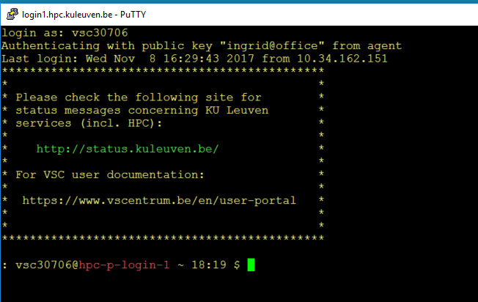




Genius Overview
Compute nodes
Large memory nodes
GPU nodes
Exp nodes
Thin nodes
+ 96x Skylake 36c 192 GB
+ 144x CascadeLake 36c 192 GB
BigMem
+ 10x Skylake 36c 768GB
+ 1x Superdome 112c 6 TB
GPUs
+ 20x Skylake 36c 192 GB 4x P100 16GB
+ 2x CascadeLake 36c 768GB 8x V100 32GB
AMD
4x AMD Naples 64c 256 GB

Slide 22
Tier-2 Cluster: Genius
Type of node | CPU type | Inter-connect | # cores | installed mem | local discs | # nodes
SkyLake | Xeon 6140 | IB-EDR | 36 | 192 GB | 800 GB | 86
SkyLake large mem | Xeon 6140 | IB-EDR | 36 | 768 GB | 800 GB | 10
SkyLake GPU | Xeon 6140 4xP100 SXM2 | IB-EDR | 36 | 192 GB | 800 GB | 20
CascadeLake | Gold 6240 | IB-EDR | 36 | 192 GB | 800 GB | 144
CascadeLake GPU | Gold 6240 8xV100 SMX2 | IB-EDR | 36 | 768 GB | 800 GB | 2
SkyLake Superdome | Gold 6132 | Flex Grid | 14 | 6 TB | 6 TB | 8

Slide 23

wICE Overview
Compute nodes
Large memory nodes
GPU nodes
Interactive nodes
Thin nodes
+ 172x Icelake 72c 256 GB
BigMem
+ 5x Icelake 72c 2 TB
GPUs
+ 4x Icelake 72c 512 GB 4x A100 80 GB
+ 5x Icelake 64c 512 GB 1x A100 80 GB

Slide 24
Tier-2 Cluster: wICE
Type of node | CPU type | Inter-connect | # cores | installed mem | local discs | # nodes
Icelake | Xeon 8358 | IB HDR-100 | 72 | 256 GB | 960 GB | 172
Icelake large mem | Xeon 8358 | IB HDR-100 | 72 | 2048 GB | 960 GB | 5
Icelake GPU | Xeon 8358 4xA100 SXM2 80GB | IB HDR-100 | 72 | 512 GB | 960 GB | 4
Icelake Interactive | Xeon 8358 1xA100 SXM2 80GB | IB HDR-100 | 64 | 512 GB | 960 GB | 5

Slide 25
 | Tier 2 | Tier 1
Access | All researchers and students | Approved project experienced users
Start with | 2,000 introduction credits | 500 node days starting grant
Project Credits | Pay as you GO | Panel Review Project proposal Free
Computation Limit | None | 500 - 5,000 node days
Application deadline | None | 3 February 5 June 2 October
Max. Project Duration |  | 8 months
Available walltime | 1h, 24h, 72h, 7d | Max. 3 days
Tier0
BrENIAC
Tier1
Tier2
Notes:
The TAB reviewers (international team) are appointed by FWO.
Application form: https://www.vscentrum.be/tier1
We support your application (technicalities, scale up, configuration etc) if you send us your application form max 1 week before the cut-off deadline.
Intro credits: https://admin.kuleuven.be/icts/onderzoek/hpc/request-introduction-credits
Project credits: https://icts.kuleuven.be/sc/forms/Aanvraagformulier_HPC_Credits
1,000 credits = 3.5 EURO
For all services check the ICTS service catalog: https://icts.kuleuven.be/sc

Slide 26
Tier-1 vs Tier-2
 | Tier 2 | Tier 1
Access | Project Credits | Panel Review ^{[1,2]}
Free Introduction Credits | 2,000 credits ^{[4]} | 500 node days ^{[2]}
Project Credits | Pay as you GO ^{[5,6]} | Free (if approved) ^{[3]}
Computation Limit | None | 500 - 5,000 node days
Application deadline | None | 3 February 5 June 2 October
Max. Project Duration | Unlimited | 8 months
Available walltime | 1h, 24h, 72h, 7d, 21d | Max. 3 days
The TAB reviewers (international team) are appointed by FWO.
Application form: https://www.vscentrum.be/tier1
We support your application (technicalities, scale up, configuration etc) if you send us your application form max 1 week before the cut-off deadline.
Intro credits: https://admin.kuleuven.be/icts/onderzoek/hpc/request-introduction-credits
Project credits: https://icts.kuleuven.be/sc/forms/Aanvraagformulier_HPC_Credits
1,000 credits = 3.5 EURO
For all services check the ICTS service catalog: https://icts.kuleuven.be/sc

Slide 27
Technical Hardware Specifications
 | Tier 2
Cluster name | Genius |  |  | wICE
Processor type | SkyLake |  | Cascade Lake | Ice Lake
Cores per node | 36 |  | 36 | 72
Base Clock Speed | 2.3 GHz |  | 2.6 GHz | 2.6 GHz
Total nodes | 86 | 10 | 144 | 172 | 5 | 5 + 4
Node memory (GB) | 192 | 768 | 192 | 256 | 2048 | 512
Memory per core (GB) | 5.2 | 21.2 | 5.3 | 3.4 | 25 | 6.8
Total cores | 3,456 |  | 4,320 | 13,392
Peak performance (Flops/cycle) | 16 DP FLOPs/cycle: 8-wide FMA (fused multiply-add) instructions AVX-512 |  | 16 DP FLOPs/cycle: 8-wide FMA (fused multiply-add) instructions AVX-512
Network | Infiniband EDR |  | Infiniband EDR | Infiniband HDR-100
Cache (L1 KB/L2 KB/L3 MB) | 18x(32i+32d) / 18x1024 / 25 MB |  | 18x(32i+32d) / 18x1024 / 25 MB | 72x(48i+32d) / 72x 1280K / 48 MB

Slide 28
Storage

Slide 29
Overview of the storage infrastructure
Your files are owned only by you. Other VSC users have no permission to read/write/execute your files (POSIX)
A VSC account has 3 default storages (free of charge) - $VSC_HOME - $VSC_DATA - $VSC_SCRATCH
You can additionally request staging storage
Different storage volumes have different: - mount point - size and performance - use case - backup and maintenance policy
More info on ICTS Service Catalog (EN/NL)

Slide 30
Storage
Request form for extra storage
More information
Do not use /tmp It is only 10 GB and is reserved for the OS and root processes Your application can crash if using /tmp
You are automatically logged into your home folder upon login. Make sure you immediately go to your other storages, e.g. $ cd $VSC_DATA
Always check your storage balance using myquota command
Example
$ myquota
file system $VSC_HOME
Blocks: 1479M of 3072M
Files: 12934 of 100k
file system $VSC_DATA
Blocks: 12G of 75G
Files: 1043k of 10000k
file system $VSC_SCRATCH
Blocks: 15M of 1.5T

Slide 31
Storage Areas
Env. Variable | $VSC_HOME | $VSC_DATA | $VSC_SCRATCH
Full Path | /usr/leuven/3XX/vsc3XXXX | /data/leuven/3XX/vsc3XXXX | /scratch/leuven/3XX/vsc3XXXX
Filesystem Type | NFS | NFS | Lustre
Access | Global | Global | Global
Backup | Yes (hourly/daily/weekly) | Yes (hourly/daily/weekly) | No files are deleted 28 days after last access
Quota | 3 GB | 75 GB | 500 GB
Extension | No | paid | free
Use Case | Storing SSH key & config files | Install software, keep codes and data for longer term | Intensive I/O, temporary storage

Slide 32
Storage
Storage | home folder
Env. Variable | $VSC_HOME
Filesystem Type | NFS
Access | Global
Backup | Hourly, daily, weekly (until last month) inside the .snapshot folder.
Default Quota | 3 GB
Extension | Not possible
Usage | Only storing SSH keys, config files
Remarks | - Stay away from using it - Can easily overflow: + Your jobs may crash + Login issues
home
data
scratch
node scratch
staging
archive

Slide 33
Storage
Storage | data folder
Env. Variable | $VSC_DATA
Filesystem Type | NFS
Access | Global
Backup | Hourly, daily, weekly (until last month) inside the .snapshot folder.
Default Quota | 75 GB
Extension | On purchase
Usage | Your data, code, software, results
Remarks | Permanent storage for initial/final results Not optimal for intensive or parallel I/O
home
data
scratch
node scratch
staging
archive

Slide 34
Storage
Storage | scratch folder
Env. Variable | $VSC_SCRATCH
Filesystem Type | Lustre
Access | Global
Backup | delete after 30 days from last access
Default Quota | 500 GB
Extension | Free
Usage | Intensive, parallel I/O, temporary files
Remarks | Recommended storage for all jobs Copy scratch files to VSC_DATA or local storage after jobs are done Deleted files cannot be recovered
home
data
scratch
node scratch
staging
archive

Slide 35
Storage
Storage | Node scratch folder
Env. Variable | $VSC_SCRATCH_NODE
Filesystem Type | Lustre
Access | On compute node, only at runtime
Backup | None
Default Quota | 591 GB
Extension | Read about beeOND
Usage | Temporary storage at runtime
Remarks | Fastest I/O, attached to the node Is cleaned after job terminates Copy the data to your home, scratch, or staging before job ends
home
data
scratch
node scratch
staging
archive

Slide 36
Storage
Storage | Staging folder
Path | /staging/leuven/stg_000XX
Filesystem Type | Lustre
Access | On demand, only Tier-2@KUL
Backup | None
Default Quota | None
Extension | On purchase, from 1 TB
Usage | Permanent; share with a group
Remarks | Accessible from login/compute nodes Fast, parallel I/O
home
data
scratch
node scratch
staging
archive

Slide 37
Storage
Storage | Archive folder
Path | /archive/leuven/arc_000XX
Filesystem Type | NFS
Access | On demand, only Tier-2@KUL
Backup | None
Default Quota | None
Extension | On purchase, from 1 TB
Usage | Permanent; share with a group
Remarks | Accessible only from login nodes Cannot use it from compute nodes Slow, but durable filesystem
home
data
scratch
node scratch
staging
archive

Slide 38
Directory structure
Location of installed modules
Location of $VSC_HOME directories
Location of $VSC_DATA directories
/
Location of $VSC_SCRATCH directories
/boot
/dev
/proc
/local_scratch
/apps
/user
/data
/scratch
……..
……..
antwerpen
brussel
gent
leuven
antwerpen
brussel
gent
leuven
icts
skylake
training
300
304
317
2014a
2015a
2016a
vsc30400
vsc30468
vsc30499
……..
……..

Slide 39
Directory structure
Location of installed modules
Location of $VSC_HOME directories
Location of $VSC_DATA directories
/
Location of $VSC_SCRATCH directories
/boot
/dev
/proc
/local_scratch
/apps
/user
/data
/scratch
……..
……..
antwerpen
brussel
gent
leuven
antwerpen
brussel
gent
leuven
icts
skylake
training
300
304
317
2014a
2015a
2016a
vsc30400
vsc30468
vsc30499
……..
$VSC_HOME

Slide 40
Directory structure
Location of installed modules
Location of $VSC_HOME directories
Location of $VSC_DATA directories
/
Location of $VSC_SCRATCH directories
/boot
/dev
/proc
/local_scratch
/apps
/user
/data
/scratch
……..
……..
antwerpen
brussel
gent
leuven
antwerpen
brussel
gent
leuven
icts
skylake
training
300
304
317
2014a
2015a
2016a
vsc30400
vsc30468
vsc30499
……..
$VSC_DATA

Slide 41
Directory structure
Location of installed modules
Location of $VSC_HOME directories
Location of $VSC_DATA directories
/
Location of $VSC_SCRATCH directories
/boot
/dev
/proc
/local_scratch
/apps
/user
/data
/scratch
……..
……..
antwerpen
brussel
gent
leuven
antwerpen
brussel
gent
leuven
icts
skylake
training
300
304
317
2014a
2015a
2016a
vsc30400
vsc30468
vsc30499
……..
$VSC_SCRATCH

Slide 42
Directory structure
Location of installed modules
/
modules
logs
software
/boot
/dev
/proc
/local_scratch
/apps
/opt
GCC
matlab
Python
antwerpen
brussel
gent
leuven
2.7.14-foss-2018a
2.7.14-intel-2018a
……..
……..
icts
skylake
training
……..
bin
include
lib
2018a
2017b
2016a
cython
python
pip
Location of python (from module Python/2.7.14-foss-2018a)

Slide 43
Directory structure
Location of installed modules
Path on Genius:
/apps/leuven/skylake/2018a/software/Python/2.7.14-foss-2018a
/
modules
logs
software
/boot
/dev
/proc
/local_scratch
/apps
/opt
GCC
matlab
Python
antwerpen
brussel
gent
leuven
2.7.14-foss-2018a
2.7.14-intel-2018a
……..
……..
icts
skylake
training
……..
bin
include
lib
2018a
2017b
2016a
cython
python
pip
Location of python (from module Python/2.7.14-foss-2018a)

Slide 44
Login Nodes & MFA

Slide 45

Accessing a Cluster
Compute nodes
Firewall
Infiniband interconnect
Link to other VSC sites
Scientist
SSH Authentication
Administration - queue system, job scheduler, user management,…
Login nodes
Service nodes
Storage

Slide 46
Using Login Nodes
To develop and/or compile code and/or software
To check your storage and credit balance
To manage jobs (submit, check status, debug, resubmit, …)
To move data around within VSC: use data, scratch, staging outside VSC: copy/sync from/to your local storage
To pre-process or post-process your data/jobs
To visualize your data
To share files/folders
Tips
Login nodes are shared resources
Do not execute heavy-lifting tasks (core, memory)
Instead, submit jobs
Warning

Slide 47
Login Host Names
Windows: PuTTY or MobaXterm or NX Linux/Mac: terminal or NX
To login, you need an active VSC number and a hostname $ ssh –X vscXXXXX@<hostname>
Cluster / Partition | <hostname> | Remark(s)
Genius | login.hpc.kuleuven.be login-genius.hpc.kuleuven.be | Recommended
 | login{1,2}-tier2.hpc.kuleuven.be | No GPU
 | login{3,4}-tier2.hpc.kuleuven.be | Nvidia Quadro P6000

Slide 48
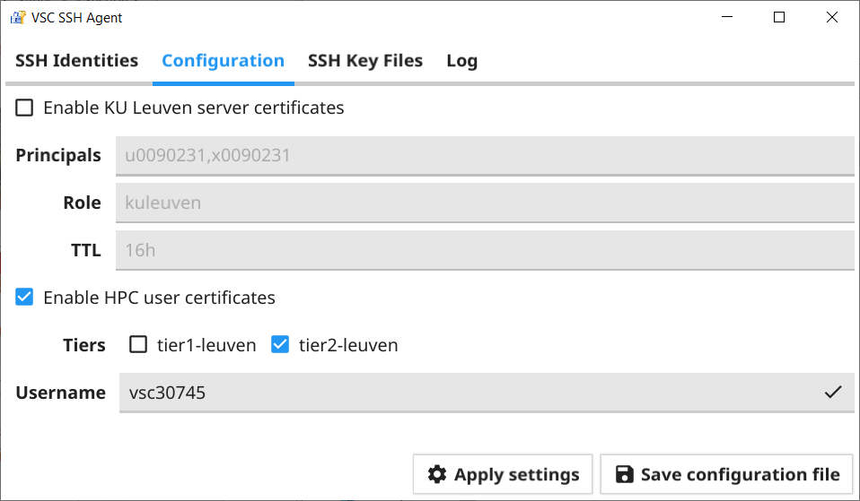
VSCAgent
SSH Agent holds your private key and certificates
Automatic authentication whenever needed
More info: https://docs.vscentrum.be/en/latest/leuven/mfa_quickstart.html?highlight=vscagent
Download: https://firewall.vscentrum.be/vscagent/latest/
Launch and configure
1
2
3
4

Slide 49
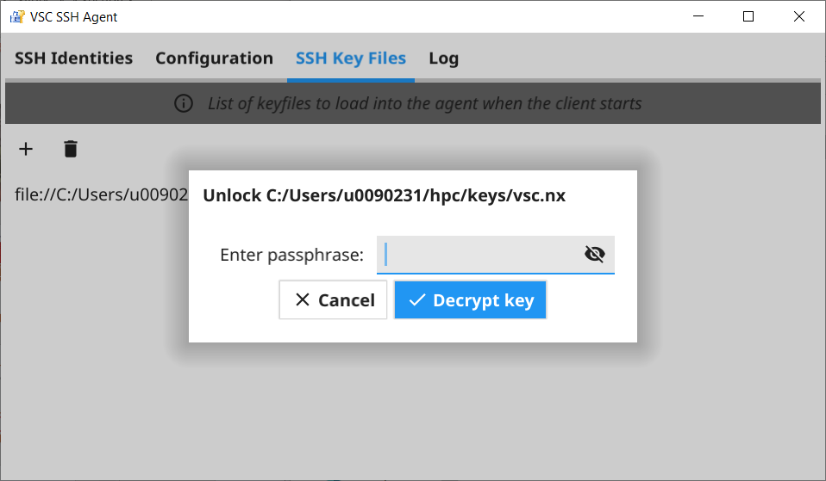
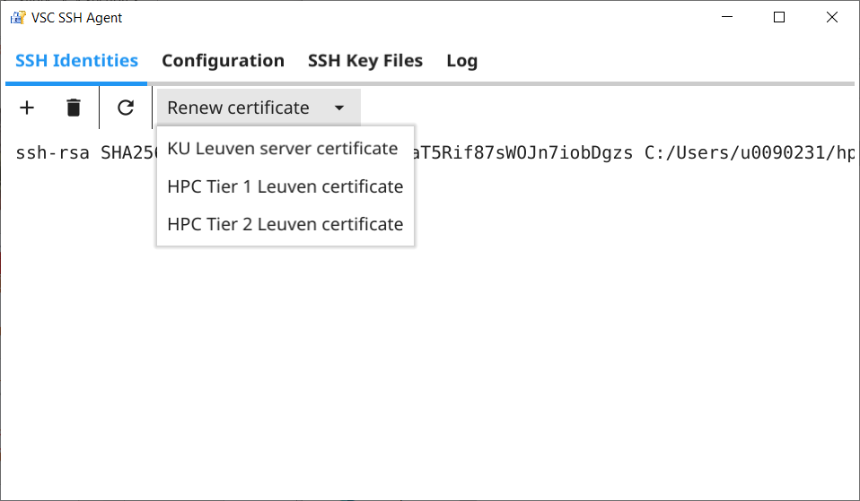
VSCAgent
5
7
6
8

Slide 50
Login Setup
PuTTY
Terminal

Slide 51
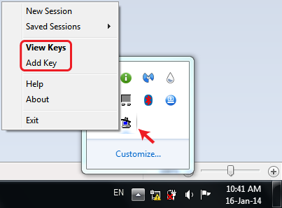
Activate Your SSH Agent (Windows only)
When you install PuTTY, the agent called Pageant is automatically installed
Open Pageant; it hides inside your bottom-right tray
Click on “Add Key” and brows to your private key(s) folder
After choosing a key, you are asked for a passphrase
If successful, agent always remembers your SSH keys and Certificates (Multi-Factor Authentication)

Slide 52
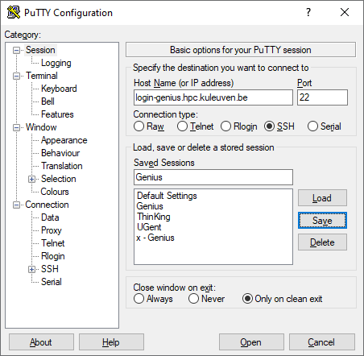
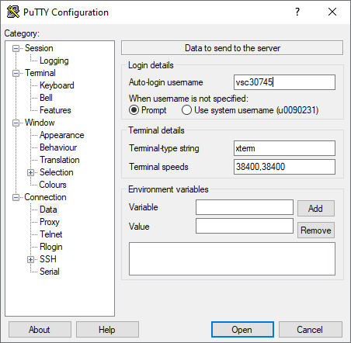
Setup PuTTY in 12 Clicks (Windows only)
1
5
2
3
4

Slide 53
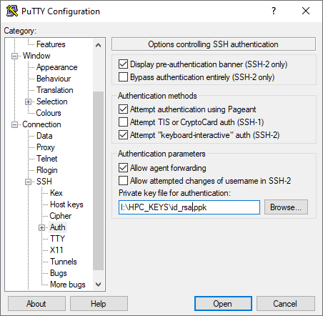
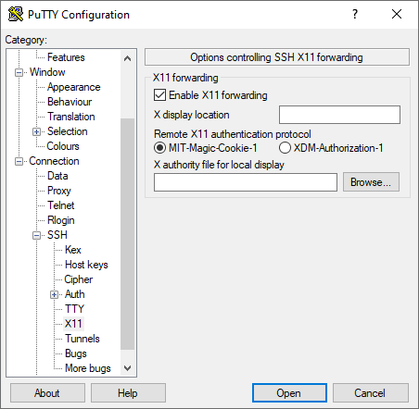
Setup PuTTY in 12 Clicks (Windows only)
10
7
8
6
9

Slide 54
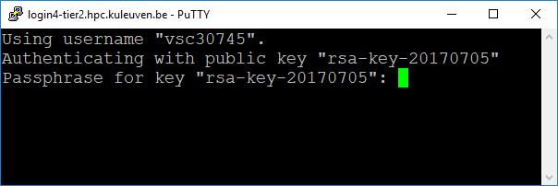
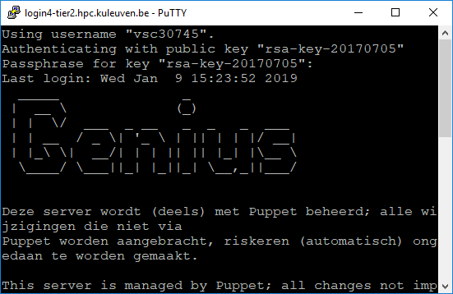
Setup PuTTY in 12 Clicks (Windows only)
If PuTTY asks for password, exit immediately, and check the path to your private key. Else you will be blocked for 24h.
11
12

Slide 55

Connecting via Terminal (Linux and Mac)
If asked for password, please stop connecting and contact suport, otherwise after a few attempts you will be blocked for 24h.
Check your SSH Agent. Is your SSH key found? $ ssh-add –l
If your key is not found, add it to the agent: $ ssh-add </path/to/my/private/keyfile>
Try to ssh now $ ssh vscXXXXX@<hostname>

Slide 56
NX
About
Setup

Slide 57
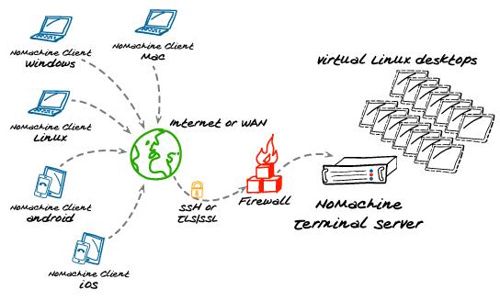
NX – The Graphical Login
NX is:
a graphical remote desktop server
login to VSC
start a virtual Linux instance(s)
Client: NoMachine
Configuration Guide
Using OpenSSH key Convert your key

Slide 58
Advantages of NX
Graphical login
A session stays alive/active even if you close your client (e.g. laptop)
Resume a session, and immediately keep working where you left off
More interactive jobs
Available apps: Internet browser, terminal, … Text editor, PDF reader, Image viewer, … Matlab, RStudio, SAS
Remark: NX is shared among tens of users Do not compute/test your code there Instead, submit jobs from NX to compute nodes

Slide 59
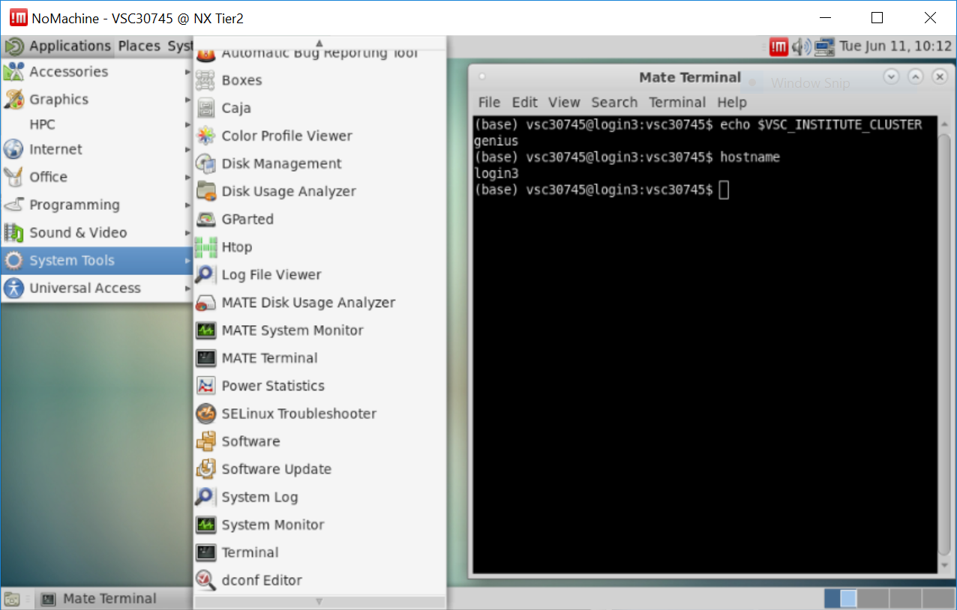
NX virtual desktop
NX server is hosted on two Genius login nodes

Slide 60
NX: available software
Accesories: Gedit, Vi IMproved, Emacs (dummy version), Calculator
Graphics: gThumb (picture viewer), Xpdf Viewer
Internet: Firefox
HPC: Computation: Matlab (2018a), RStudio, SAS
Visualisation: Paraview, VisIt, VMD
Programming: Meld Diff Viewer (visual diff and merge tool)
System tools: File Browser, Terminal
Additionally: Gnuplot (graphing utility), Filezilla (file transfer tool), Evince (PDF, PostScript, TIFF, XPS, DVI Viewer)
Software launched though modules from Terminal.

Slide 61
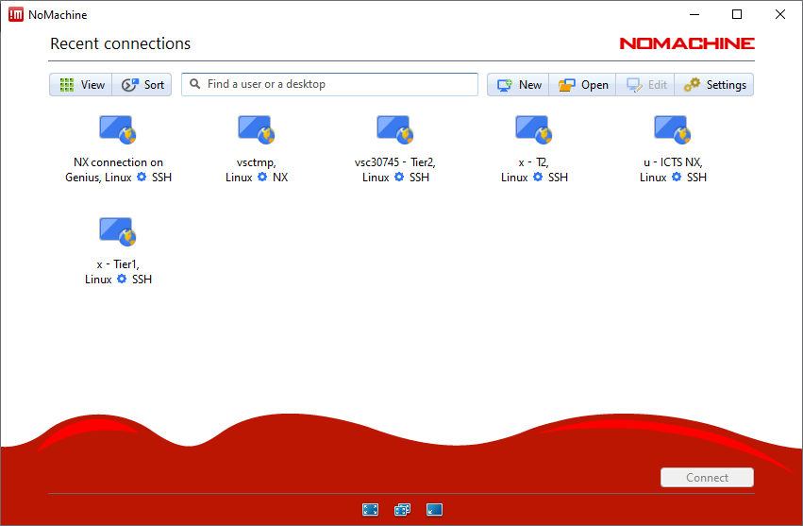
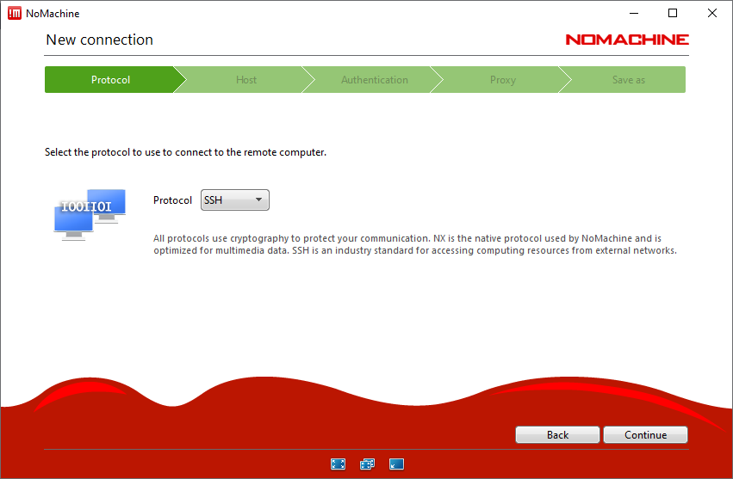
Setup NX in 10 Steps
1
2

Slide 62
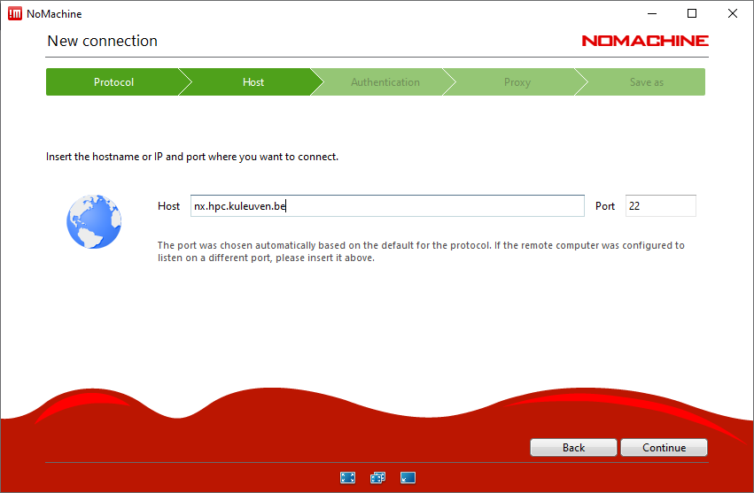
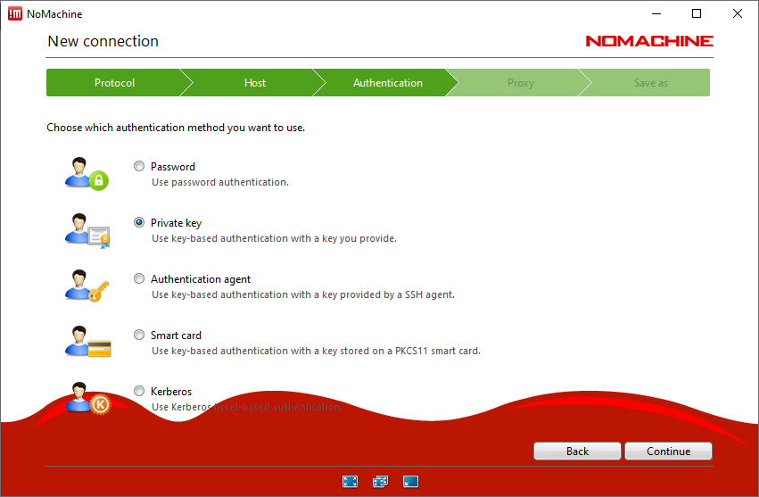
Setup NX in 10 Steps
3
4
Host: nx.hpc.kuleuven.be

Slide 63
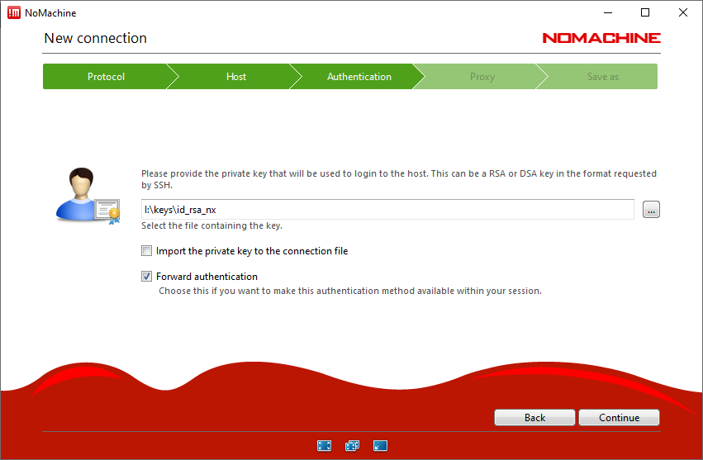
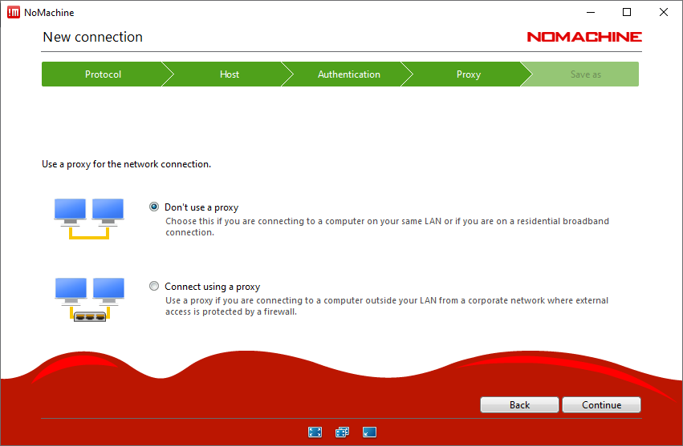
Setup NX in 10 Steps
5
6
5

Slide 64
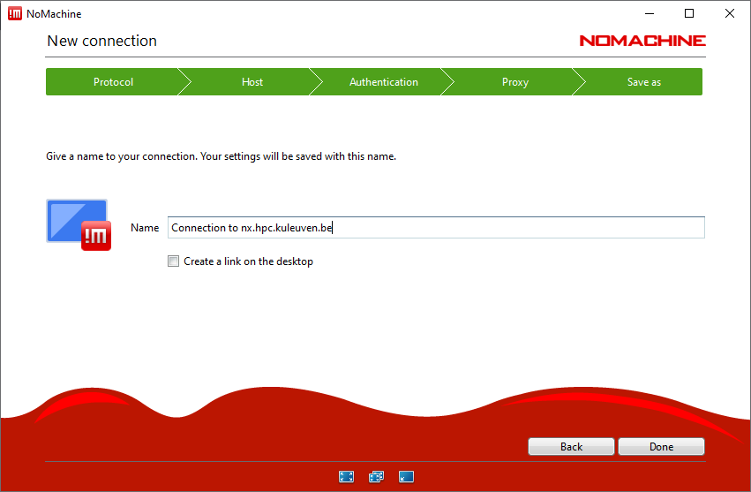
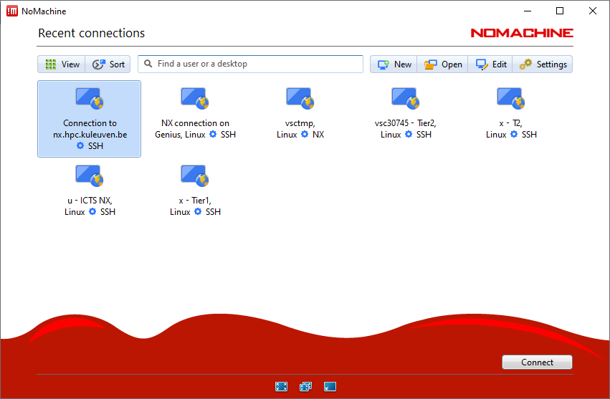
Setup NX in 10 Steps
8
7
8

Slide 65
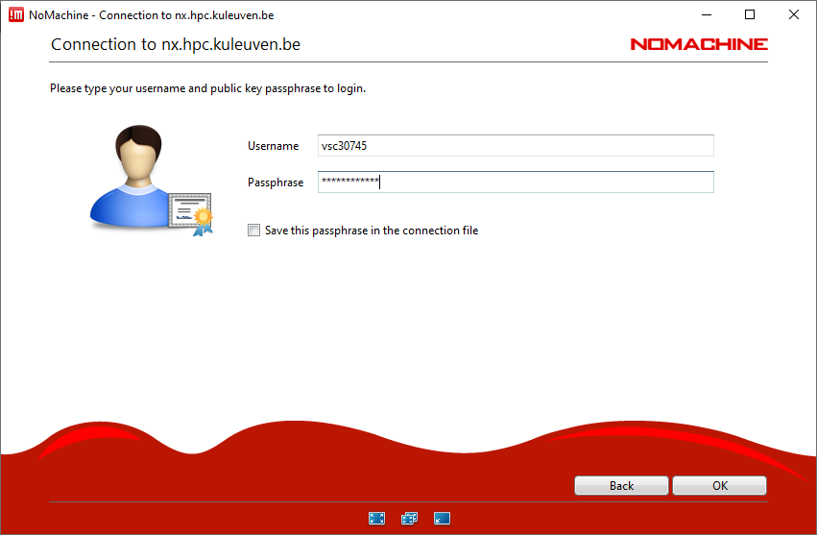
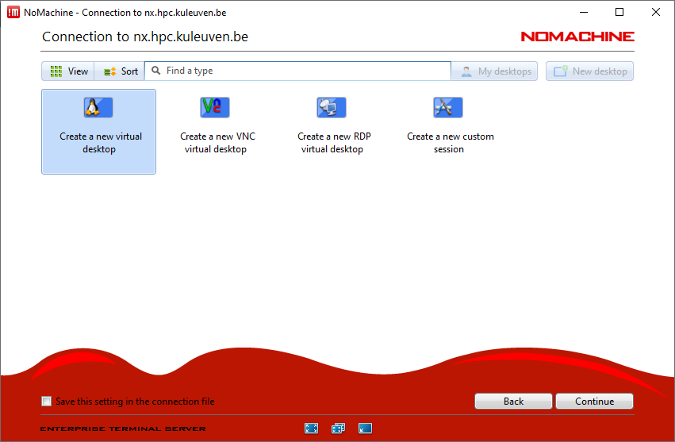
Setup NX in 10 Steps
9
10
You need to remember your VSC number and the passphrase (that you entered when creating the SSH keypair)
10

Slide 66
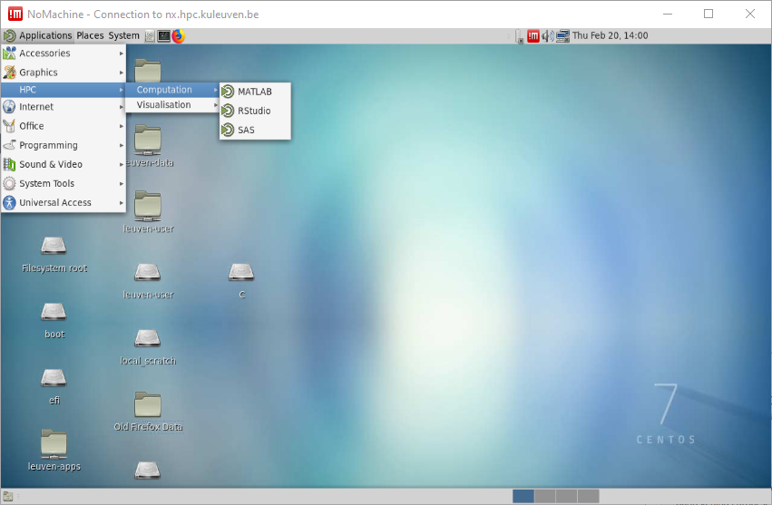
NX is a graphical login node
A new session stays active for long
Rich suite of applications; e.g. Terminal, Firefox, text editor, Matlab, RStudio, SAS etc.
NX is a shared, login-node. Please do not compute on NX.
NX server is attached to Genius. Jobs submitted from NX will appear in Genius queue

Slide 67
File Transfer with FileZilla

Slide 68




File transfer
Local Files
VSC Account
Application | OS
FileZilla | Windows, Linux, Mac
WinSCP | Windows
rsync, scp | Linux, Mac
Globus | Window, Linux, Mac
68

Slide 69
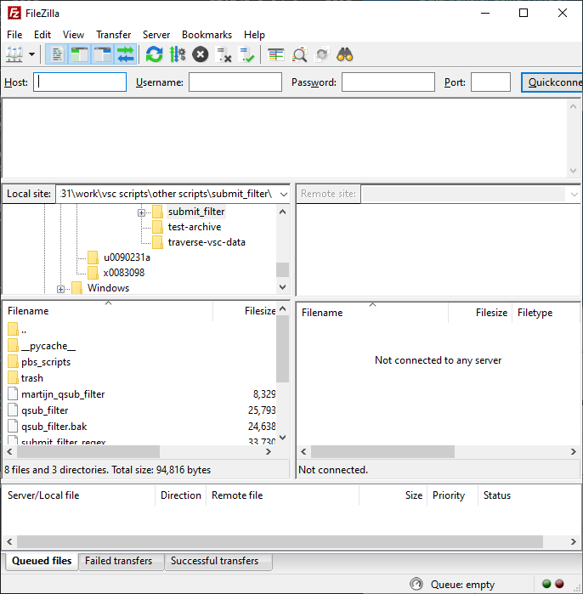
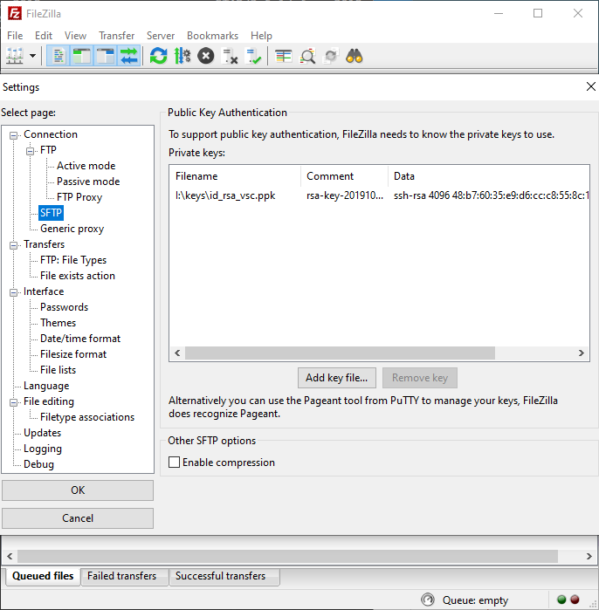
File transfer
1
Edit -> Settings
2
4
3
69

Slide 70
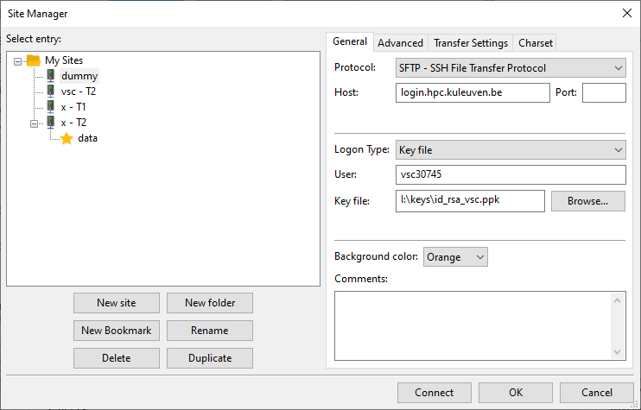
File transfer
6
7
8
5
9
70

Slide 71
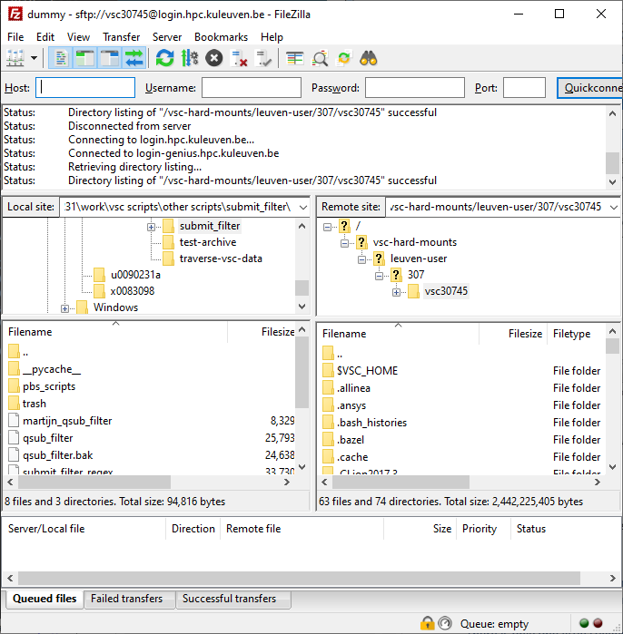
For convenience, you’d better bookmark your data and scratch folders!
Instead, go to your $VSC_DATA folder, e.g. /data/leuven/399/vsc39934
Your local machine (e.g. laptop)
Your VSC storage (e.g. $VSC_DATA, $VSC_SCRATCH). Note: by default you arrive at your own $VSC_HOME. Copy nothing there!
71

Slide 72
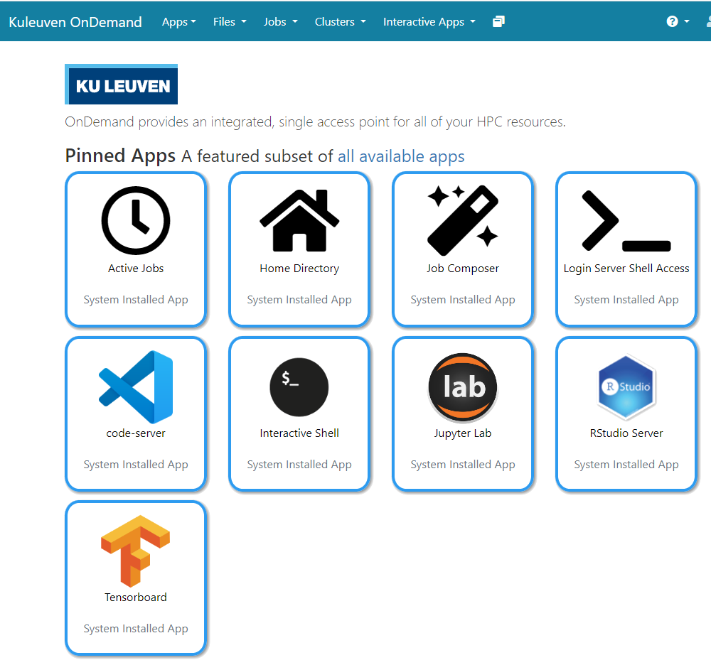

Open OnDemand
Access wICE via web browser
https://ondemand.hpc.kuleuven.be
Login via KULeuven MFA
File browser
Interactive apps + integrated shell
Create, start and monitor jobs
Develop, compile and test your code
VSCode editor
Jupyter Lab, RStudio and Tensorboard

Slide 73
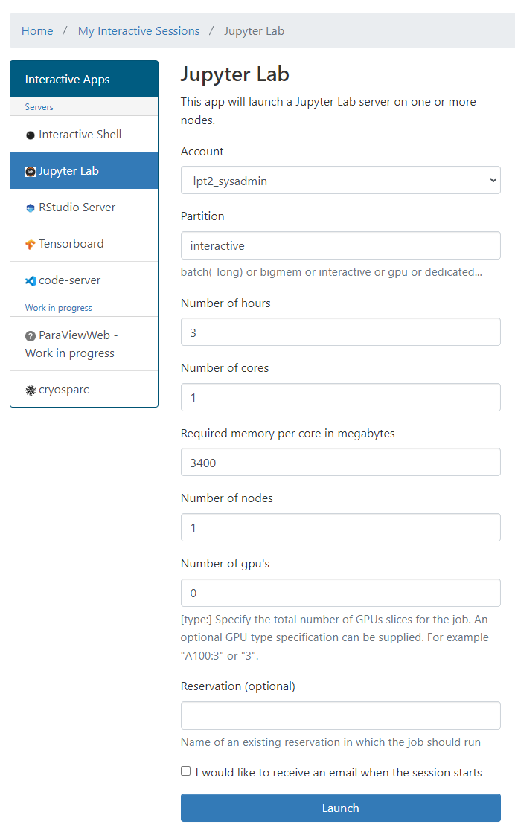
Open OnDemand
E.g. to start a Jupyter Notebook
Pick a valid Slurm credit account
Default partition: batch interactive: Max 8 cores, 1 GPU, 16 hr
Default resources: 1 core, 1 hour, 3400MB RAM, no GPU
(At the moment) you cannot use scratch and staging

Slide 74
Software Stack

Slide 75
Software: Available Modules
OS: Linux CentOS 7.x (Genius) and Rocky Linux 8.x (wICE)
Toolchains (Genius): Intel 2018a (icc, icpc, ifort; Intel MPI; Intel MKL) FOSS 2018a (gcc, g++, gfortran; OpenMPI; ScaLAPACK, OpenBLAS, FFTW)
wICE: default is 2021a
Note: Never mix FOSS and Intel compilers (gives dependency conflict)
Command | Remark
module av | List all installed modules
module av Python | List all Python-related modules
module use /apps/leuven/skylake/2021a/modules/all | Expose other modules from non-default toolchains, by including them in the search
module spider Python | Get more info
module load Python/3.6.4-intel-2018a | Load a specific module
module list | List all loaded modules and their dependencies
module unload Python/3.6.4-intel-2018a | Unload a module (but dependencies still stay)
module purge | Remove all modules from your work session

Slide 76
Software: Your Specific Needs
You can always install your desired software in your $VSC_DATA Use Intel or FOSS toolchains
Compile your code on a compute node (with interactive job)
If you cannot, ask us for help
Python/R packages for AI and ML must be installed by the users themselves
Read more about Python Package Management
Read more about R Package Management

Slide 77
Starting to Compute

Slide 78


Prices
Introduction credits
Maximum 2000
Project credits
Commercial partner 0.06 €
Storage
Internal funding, IWT, FWO, European funding 0.0035 €
/scratch, temporary quota upgrade
HPC archive 1 TB, 70 €/year
Application support
Software Installation
Training
Scheduled courses
Thematic workshops
/data 25 GB , 14.63 €/year
Debugging & profiling up to 5 days
Parallelization & optimization up to 5 days
Infosessions
Valid up to 6 months
/staging 1 TB, 130 €/year
Minimum purchase 5000 credits
Prices and information: https://icts.kuleuven.be/sc/english/HPC

Slide 79
Extra services
Request introduction credits https://admin.kuleuven.be/icts/onderzoek/hpc/request-introduction-credits
Request project credits (create your group first) https://admin.kuleuven.be/icts/onderzoek/hpc/request-project-credits https://icts.kuleuven.be/sc/forms/Aanvraagformulier_HPC_Credits
Extra project credits (to add to existing project) https://admin.kuleuven.be/icts/onderzoek/hpc/extra-project-credits
Request extra storage
https://admin.kuleuven.be/icts/onderzoek/hpc/hpc-storage

Slide 80
Text editors
Some text editors:
nano: easiest editor
gedit: notepad-like (needs X-forwarding!)
vim
emacs (X-window) or emacs -nw (terminal)

Slide 81







Resource Glossary
Nodes: how many compute servers to request?
Cores: how many cores per node to use?
Memory requirement: how much memory each core needs?
Partition: gpu, bigmem, superdome, amd
Walltime: how long to use resources?
Storage: how much storage (data, scratch, etc) the job needs?
Credits: how many compute credits will be consumed?

Slide 82
Serial Application (1 process on 1 core)
Single Process
One node
Multi-Core Appl. (N threads on N cores from 1 node)
Thread Group
Distributed Appl. (many processes on
multiple cores/nodes)
Process Group

Slide 83
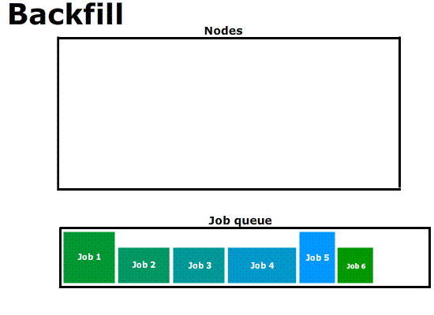

Slide 84



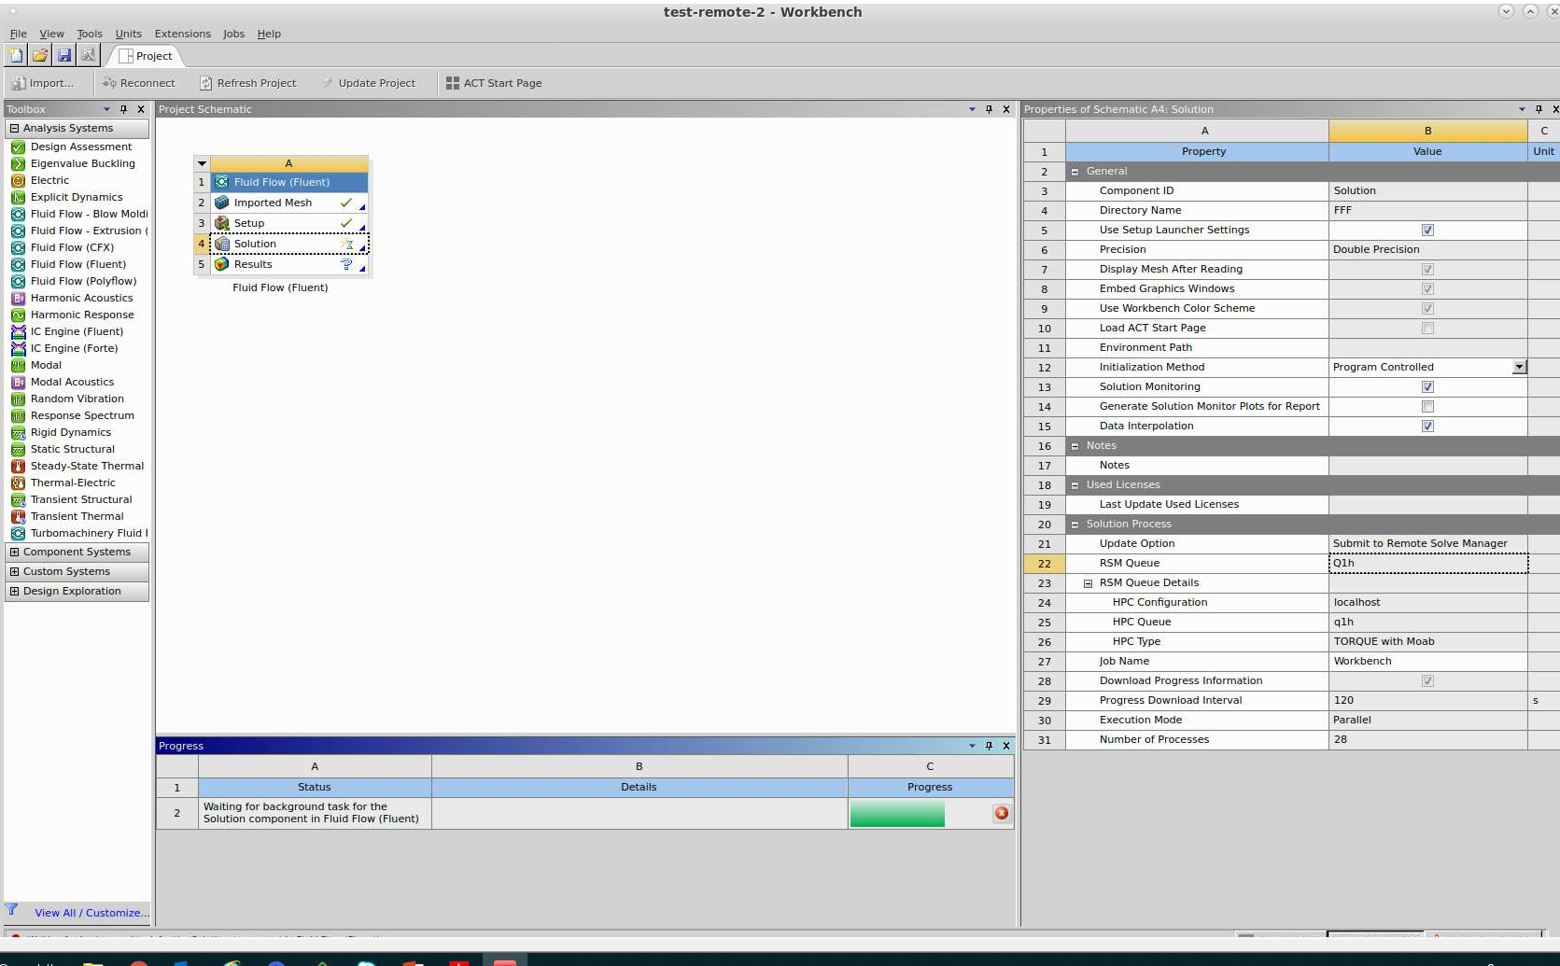
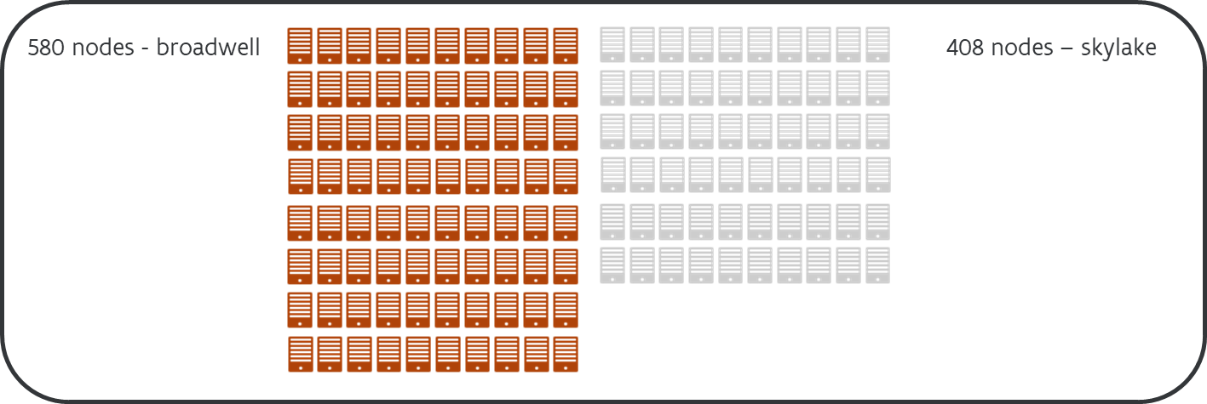
Ways to use the cluster
INTERACTIVE GUI WORKLOAD
BATCH WORKLOAD
INTERACTIVE WORKLOAD
Login
NX
Storage

Slide 85



Interactive Job
Compute nodes
Login node
srun …
Batch Job
Compute nodes
Login node
sbatch script.pbs

Slide 86
Batch vs. Interactive Jobs
 | Batch Jobs | Interactive Jobs
Command | $ qsub <jobscript.sh> | $ qsub –I …
Workflow | Job runs remotely on compute nodes | User logs in to the compute node
Benefits | + User does not care when the job starts + STDOUT/STDERR are redirected to files | + User experiences the actual compute environ. + Run/test/repeat your work even if it fails
Drawbacks | - If the application fails, your job terminates | - You might wait too long in the queue
Use Cases | Compute | Install software Test/debug/benchmark software Check resource usage by a software

Slide 87
Interactive Job on wICE
Request interactive job
Project Name for Compute Credits
Target cluster
$ srun -n 1 -t 01:00:00 -A <project name> -p interactive –M wice --pty bash -l
-
Number of tasks
Max. Runtime
For interactive jobs
Interpret with Bash
Remark
- Specifying <project name> for credits is mandatory, e.g.: –A lp_hpcinfo
- Implicit defaults for an interactive job on wICE are: -n 1, -t 01:00:00, --mem-per-cpu=2000M

Slide 88
Interactive Jobs
Interactive job: 1 core for 1 hour (default) $ srun –M wice –A lp_hpc --pty /bin/bash -l
Interactive job with X-forwarding $ srun –M wice –A lp_hpc –x11 --pty /bin/bash -l
Request fraction of a node from interactive partition $ srun –M wice –A lp_hpc –N 1 –n 4 –p interactive --pty /bin/bash –l
Request a GPU accelerator $ srun –M wice –A lp_hpc –N1 –n 18 –p gpu –G 1 --pty /bin/bash -l

Slide 89
Example: Slurm Job Script
Shebang
#!/bin/bash -l
#SBATCH –-cluster wice #SBATCH –-account lp_hpcinfo_training #SBATCH –-nodes 1 #SBATCH –-ntasks 4 #SBATCH --mem-per-cpu 4G #SBATCH –-job-name hpc_workflow #SBATCH --mail-type BEGIN,END,FAIL #SBATCH --mail-user my.name@kuleuven.be
Module --force purge module load intel/2021a module load Python/3.9.5-GCCcore-10.3.0
which python3
cd $VSC_SCRATCH/projects/simulations
cp –r $VSC_DATA/input_data .
python modelling.py
cp –r output_data $VSC_DATA
rm –rf ./input_data ./output_data
Resource List
Module load(s)
Move data
Execure commands
Move data

Slide 90
Batch Workload
Job Script
#!/bin/bash -l
…
Submit the job to the batch server
Receive a unique JobID
Error and output files
Command Line
$ sbatch simulation.slurm
JobID
Submitted batch job 60042478 on cluster wice
stderr, stdout
$ ls *.out slurm-60042478.out

Slide 91
Output File
STDOUT + STDERR
STDERR and STDOUT are by default redirected to a single file:
slurm-<JobID>.out
Contains job info, all errors and warnings, and printouts
Always study it
Address all warnings and errors (if you can)
Typical error examples …
$ ls slurm-*.out slurm-60042478.out
Out of Memory
slurmstepd: error: Detected 1 oom-kill event(s). Some of your processes may have been killed by the cgroup out-of-memory handler.
Short Walltime
slurmstepd: error: *** JOB 60042478 ON s28c11n2 CANCELLED AT 2023-02-08T10:03:43 DUE TO TIME LIMIT ***
Low Disk Space
IOError: [Errno 122] Disk quota exceeded

Slide 92
Output File
STDOUT + STDERR
$ cat slurm-60042490.out
SLURM_JOB_ID: 60042490
SLURM_JOB_USER: vsc30745
SLURM_JOB_ACCOUNT: lp_hpcinfo
SLURM_JOB_NAME: hpc_workflow
SLURM_CLUSTER_NAME: wice
SLURM_JOB_PARTITION: batch
SLURM_NNODES: 1
SLURM_NODELIST: s28c11n2
SLURM_JOB_CPUS_PER_NODE: 8
Date: Wed Feb 8 10:41:21 CET 2023
Walltime: 00-01:00:00
========================================================================
/apps/leuven/skylake/2018a/software/Python/3.6.4-intel-2018a/bin/python3
cp: cannot stat '/data/leuven/307/vsc30745/input_data': No such file or directory
python: can't open file 'modelling.py': [Errno 2] No such file or directory
cp: cannot stat 'output_data': No such file or directory

Slide 93
Inspecting Jobs
Example
$ scontrol show job –M wice 60049330
JobId=60049330 JobName=f70.slurm
UserId=vsc3.…(253.…) GroupId=vsc3.…(253.…) Account=lp_metacommunity_models QOS=lp_metacommunity_models
JobState=PENDING Reason=QOSGrpBillingMinutes SubmitTime=2023-02-16T00:24:58 EligibleTime=2023-02-16T00:24:58 Partition=batch NodeList= NumNodes=4-4 NumCPUs=288 NumTasks=288 CPUs/Task=1
TRES=cpu=288,mem=979200M,node=4,billing=733 MinCPUsNode=72 MinMemoryCPU=3400M WorkDir=/vsc-hard-mounts/leuven-data/3../vsc3.…/Odonate_SOM
StdErr=/vsc-hard-mounts/leuven-data/3../vsc3.…/Odonate_SOM/slurm-60049330.out
StdIn=/dev/null
StdOut=/vsc-hard-mounts/leuven-data/3../vsc3.…/Odonate_SOM/slurm-60049330.out
Diagnosis
Why is my job in pending/hold state? Check out the “Reason” on Slurm docs: https://slurm.schedmd.com/resource_limits.html

Slide 94
Memory Considerations
Genius “Thin” Nodes have 192 GB memory each You need to leave 8 GB aside for the Operating System, and use the rest
By default, every core can have pmem = (192GB – 8GB) / (36 cores) ≈ 5GB per-core
There are 3 ways you can request larger memory than normal:
Use less cores (ppn), but larger memory-per-core (pmem)
Use bigmem partition
Use Superdome machine
You sacrifice ppn, in favor of pmem
E.g. if you need 20GB memory per core: $ qsub –l nodes=1:ppn=8,pmem=20gb …
Note: the total memory requested must be less than 192GB – 8GB = 184GB, i.e. ppn × pmem ≤ 184GB
Example

Slide 95
Standard Output File
Output File
time: 3600
nodes: 1
procs: 1
account string: lpt2_sysadmin
queue: q1h
===========================
Hello World!
===========================
Date: Fri Mar 20 14:32:01 CET 2020
Allocated nodes:
r26i27n11
Job ID: 50240161.tier2-p-moab-2.tier2.hpc. …
Resource List: pmem=5gb,walltime=01:00:00,neednodes=1:ppn=36
Resources Used: cput=00:00:01,vmem=0kb,walltime=00:00:04,mem=0kb,energy_used=0
Queue Name: q1h
----------------------------
time: 4
nodes: 1
procs: 1
account: lpt2_sysadmin
Summary
Always created
<JobScript>.o<JobID>
Contains all standard output (instead of screen)
Always study it
stdout
Resources
stdout
$ ls *.o* simulation.pbs.o50041238
summary

Slide 96
Batch job with resource specifications
From command line
$ qsub -l walltime=10:00:00 myjob.pbs
In a PBS job script
#!/bin/bash -l
#PBS -l walltime=10:00:00
#PBS -l nodes=2:ppn=36
#PBS -l pmem=5100mb
#PBS -N myjob2
#PBS -A default_project
#PBS –o $PBS_JOBID.stdout
#PBS –e $PBS_JOBID.stderr
#PBS -m ae
#PBS -M my.name@icts.kuleuven.be
If not specified: walltime=01:00:00
If not specified:
nodes=1:ppn=1
If not specified:
pmem=5100mb
If not specified: job will not start
default_project = intro credits
lp_my_project_= project credits
lp_hpcinfo_training = project credits for the course exercises
Capture standard output and error during at runtime

Slide 97
My first pbs script
Clean the modules loaded by default in .bashrc
Load all the necessary modules (new shell is started for each job)
#!/bin/bash -l
#PBS -l walltime=00:30:00
#PBS -l nodes=1:ppn=36
#PBS -N testjob
#PBS -A lp_hpcinfo_training
#PBS -m ae
#PBS -M my-name@student.kuleuven.be
module purge
module load matlab/R2016b
cd $VSC_SCRATCH
cd $PBS_O_WORKDIR
matlab -nojvm -nodisplay -r mat
exit 0
Go to the directory where your code and input files are located
$PBS_O_WORKDIR=
location from which the job was submitted
Execute the code
Do not add unnecessary statements – in case of problem real exit code is overwritten, finding source of problem may be impossible

Slide 98
Other Partitions
GPU
Big Memory
#PBS –l partition=gpu #PBS –l nodes=1:cores=9:gpus=1:skylake
#PBS –l pmem=5gb
#PBS –l partition=bigmem #PBS –l nodes=1:cores=36 #PBS –l pmem=20gb
AMD
Superdome
#PBS –l partition=amd #PBS –l nodes=1:cores=64 #PBS –l pmem=3800mb
See VSC documentation

Slide 99
Managing & Monitoring Jobs
Command | Purpose
$ qsub …. | Submit a job (batch/interactive)
$ qdel <JobID> | Delete a specific job
$ mycheckjob <JobID> | Diagnose issues with your job, if any
$ qstat -n | Status of all recent jobs
$ qstat –Q –f | Info about available queues
$ showstart <JobID> | Give a rough estimate of start time
$ showq $ showq -p gpu | Show minimal info about a queue or partition (-p)
$ pbstop $ clusterview $ queueview | Overview of the cluster Overview of the nodes, cores and GPUs Overview of the job queues
$ mam-balance | Overview of different credit projects that you can use (qsub -A <Project>)
$ mam-list-allocations | Detailed overview of your credit projects

Slide 100
Requesting Compute Resources Interactively
Submit a resource request
For Resource List
Cores per comp. node
Max. Runtime
$ qsub –I –l nodes=1:ppn=36,pmem=5gb,walltime=12:00:00 –A <project name>
For Interactive Jobs
One compute node
Memory per Core
Project Name for Computing Credits
Remarks
Specifying <project name> for credits is mandatory, e.g.: –A lp_hpcinfo_training
If you request 2000 introductory credits, you use them like: –A default_project
Implicit defaults are nodes=1:ppn=1,pmem=5gb,walltime=1:00:00

Slide 101
Other Partitions on wICE
GPU
Big Memory
#SBATCH --partition=gpu #SBATCH --nodes=1 #SBATCH --ntasks=18 #SBATCH --gpus-per-node=1
#SBATCH --partition=bigmem #SBATCH --nodes=1 #SBATCH --tasks-per-node=72 #SBATCH --mem-per-cpu=28000M

Slide 102
Managing & Monitoring Jobs
Command | Purpose
sbatch ... | Submit a batch job
srun ... | Submit an interactive job
scancel --cluster=wice <JobID> | Cancel a specific pending or running job
scontrol show job --cluster=wice <JobID> slurm_jobinfo <JobID> | Detailed job info (very useful to diagnose issues)
squeue --cluster=wice –long | Status of all recent jobs
squeue --cluster=wice –start | Give a rough estimate of start time
sinfo --cluster=wice | Info about the state of available partitions and nodes
sacct --cluster=wice --batch --job <JobID> | Show minimal info about a queue or partition
slurmtop --cluster=wice | Overview of the cluster

Slide 103
Interactive Partition
Accessible via command line and Open OnDemand
To quickly compile, test, debug your (parallel) application
To pre-/post-process your data and make visualizations
Short queue time
5 dedicated nodes on wICE
64 cores per node, 1 GPU (=7 GPU instances), 512 GB memory
Max resource per user: 8 cores, 1 GPU instance, 16 hour walltime
Interactive Job
$ srun –n 1 –p interactive –t 16:00:00 –G 1 --pty bash -l

Slide 104
GPU Partition

Slide 105
GPU Nodes
SkyLake + 4x P100
CascadeLake + 8x V100
RAM (192 GB)
RAM (768 GB)
2 CPUs
(36 cores)
2 CPUs
(36 cores)
PCI Exp.
PCI Exp.
0
1
0
1
2
3
2
3
4
5
6
7
PCI Exp.
GPUs
PCI Exp.
GPUs

Slide 106
Using P100 GPU(s)
You get …
Using 1 GPU
RAM (45 GB)
#!/bin/bash -l
#PBS -l walltime=00:30:00
#PBS –l partition=gpu
#PBS -l nodes=1:ppn=9:gpus=1:skylake
#PBS –l pmem=5gb
#PBS -N testjob
#PBS -A default_project
1 CPU
(9 cores)
PCI Exp.
PBS Script
0
1
2
3
PCI Exp.
GPUs

Slide 107
Using P100 GPU(s)
You get …
Using 2 GPUs
RAM (90 GB)
#!/bin/bash -l
#PBS -l walltime=00:30:00
#PBS –l partition=gpu
#PBS -l nodes=1:ppn=18:gpus=2:skylake
#PBS –l pmem=5gb
#PBS -N testjob
#PBS -A default_project
1 CPU
(18 cores)
PCI Exp.
PBS Script
0
1
2
3
PCI Exp.
GPUs

Slide 108
Using V100 GPU(s)
You get …
Using 1 GPU
#!/bin/bash -l
#PBS -l walltime=00:30:00
#PBS –l partition=gpu
#PBS -l nodes=1:ppn=4:gpus=1:cascadelake
#PBS –l pmem=20gb
#PBS -N testjob
#PBS -A default_project
RAM (80 GB)
1 CPU
(4 cores)
PCI Exp.
0
1
2
3
4
5
6
7
PCI Exp.
GPUs

Slide 109
Using V100 GPU(s)
You get …
Using 3 GPU
#!/bin/bash -l
#PBS -l walltime=00:30:00
#PBS –l partition=gpu
#PBS -l nodes=1:ppn=12:gpus=3:cascadelake
#PBS –l pmem=20gb
#PBS -N testjob
#PBS -A default_project
RAM (240 GB)
1 CPU
(12 cores)
PCI Exp.
0
1
2
3
4
5
6
7
PCI Exp.
GPUs

Slide 110
Peer-to-Peer Bandwidth (GB per seconds)
High | Med | Low
PCI-e
PCI-e
GPU 0
GPU 1
Dev. ID | 0 | 1 | 2 | 3
0 | 509 | 10 | 19 | 18
1 | 10 | 508 | 18 | 18
2 | 19 | 18 | 508 | 10
3 | 18 | 18 | 10 | 507
Dev. ID | 0 | 1 | 2 | 3
0 | 508 | 37 | 37 | 61
1 | 37 | 507 | 61 | 37
2 | 36 | 61 | 508 | 37
3 | 62 | 37 | 37 | 506
GPU 3
GPU 2
Bi-directional P2P: PCIe
Bi-directional P2P: NVLink (Nvidia P100)

Slide 111
Other Partitions:
Large Memory
AMD
Debugging Queue

Slide 112
Requesting Large Memory Nodes
All Thin Nodes have 192 GB memory each You need to leave 8 GB aside for the Operating System, and use the rest
By default, every core can have pmem = (192GB – 8GB) / (36 cores) ≈ 5GB per-core
There are 3 methods you can request larger memory than normal:
Use less cores (ppn), but larger memory-per-core (pmem)
Use bigmem partition
Use Superdome machine
First Method
You sacrifice ppn, in favor of pmem
E.g. if you need 20GB memory per core: $ qsub –l nodes=1:ppn=8,pmem=20gb …
Note: the total memory requested must be less than 192GB – 8GB = 184GB, i.e. ppn × pmem ≤ 184GB

Slide 113
Requesting Large Memory Nodes
Second Method
We have 10 Large Memory nodes, with 768 GB memory each
Specify –l partition=bigmem with qsub command
Each core can have pmem=(768 GB – 18 GB) / (36 cores) ≈ 20 GB per-core
E.g. $ qsub –I –l partition=bigmem,nodes=1:ppn=36,pmem=20gb …
You can also compromise ppn for pmem E.g. $ qsub –I –l partition=bigmem,nodes=1:ppn=10,pmem=75gb …
Make sure ppn × pmem ≤ 750GB

Slide 114
Requesting Large Memory Nodes
Third Method
Superdome: 8 nodes, 14 cores-per-node, 6 TB total RAM
Default pmem=50gb
numanode is total CPUs to use (max. 8)
lprocs is total number of cores to use
E.g. $ module load superdome $ qsub –l partition=superdome -q qsuperdome \ -L tasks=1:lprocs=14:place=numanode=1
E.g. $ qsub –l partition=superdome -q qsuperdome \ -L tasks=1:lprocs=42:place=numanode=3
$ qsub –l partition=superdome -q qsuperdome \ -L tasks=1:lprocs=7:place=numanode=1:memory=700gb
Request 1/8th of the machine, with 50 GB per core
Request 3/8th of the machine, with 50 GB per core
If you want to use > 50GB/core
Eg 7 cores with 100GB/core

Slide 115
(Experimental) AMD Nodes
4 nodes
2x EPYC 7501 CPUs (2.0 GHz, 32 cores)
8 memory channels / CPU
Max Mem BW 158.95 GiB/s
RAM: 256 GB
Remark: pmem=3800mb If not specified, the job will not start
Job Script
#!/bin/bash -l
#PBS -l walltime=01:30:00
#PBS –l partition=amd
#PBS -l nodes=1:ppn=64
#PBS –l pmem=3800mb
#PBS -N testjob
#PBS -A lp_my_project

Slide 116
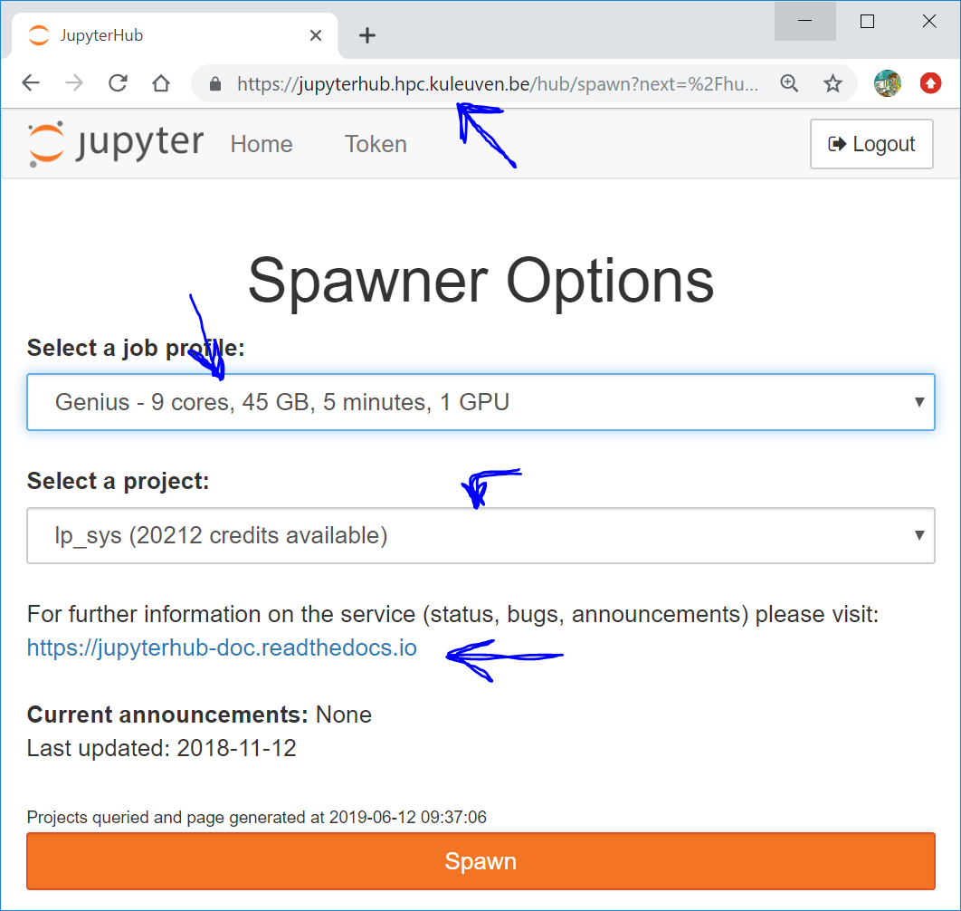
www.jupyterhub.hpc.kuleuven.be
Choose what you want
Which credit project?
Documentation

Slide 117
Jupyter Notebook on NX
Install Miniconda in your $VSC_DATA $ wget https://repo.continuum.io/miniconda/Miniconda3-latest-Linux-x86_64.sh $ bash Miniconda3-latest-Linux-x86_64.sh -p $VSC_DATA/miniconda3
Create a conda env including Jupyter $ conda create –n JupNtbk jupyter scikit-learn
Start an interactive job (qsub –I …)
Activate this env $ conda activate JupNtbk
In another terminal, launch the notebook to get URL $ jupyter notebook --ip=`hostname -i` --port=${USER:3} --no-browser --allow-root
Copy-paste the URL into NX Firefox; done

Slide 118
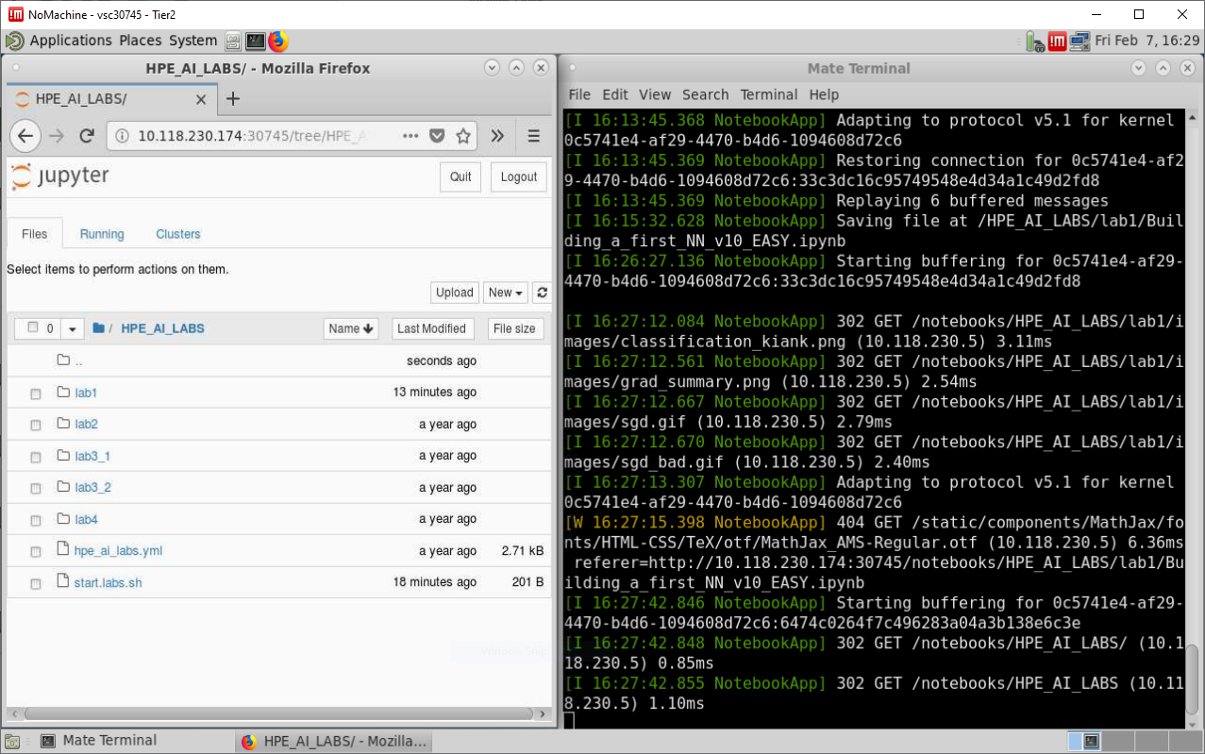

Slide 119
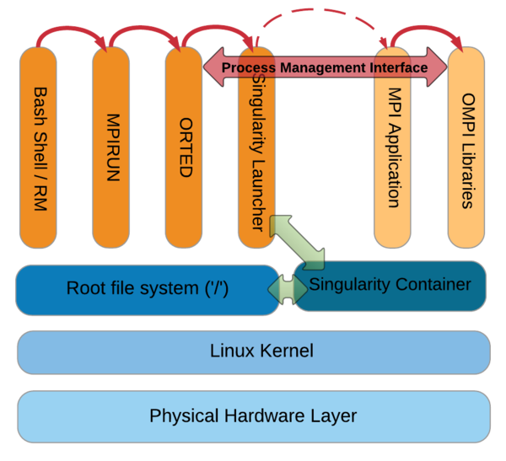
Singularity Containers
What? + Self-contained OS & software & data
Why? + fully resolved dependency chains + portable workflow
How? + You create the image + Run it on Genius + MPI/OpenMP is supported
Slurm Script
#!/bin/bash -l
#SBATCH -t 30:00 #SBATCH –N 2 #SBATCH –n 72 #SBATCH –M wice #SBATCH -A lp_hpcinfo_training
singularity run Project.simg ./model.exe

Slide 120
Where to run your jobs

Slide 121

Which system should I use?
Knowing yourself is
the beginning
of all wisdom

Slide 122
What kind of work I do?
CPU usage
Do you run single core jobs or parallel?
Single core
Is your code optimized to AVX ?
Parallel:
single node or multinode?
Single node: does my application scale? Up to how much cores ?
Multinode:
Does my application scale?
Memory usage
How much memory (per core) my jobs use?
Is your processing memory bound?

Slide 123
What kind of work I do?
How to find out
Know your algorithm
Benchmark your typical workload on the different architectures
Use tools to track behavior of your code
Use Monitor tool
Use profiling tools eg. ARM MAP or Scalasca
Consult training agenda
Upcoming Allinea ARM Forge training

Slide 124
Which system for what?
Compute nodes (thin nodes)
Thinking:
Haswell: 24 cores 64/128 GB
Genius:
Skylake: 36 cores
Cascade Lake: 36 cores
192 GB
IB EDR
Single core jobs
Worker jobs
Single node parallel jobs
Multinode parallel jobs
AVX 512
Higher core/memory ratio Higher memory bandwidth

Slide 125
Which system for what?
Compute nodes (Large memory)
Genius:
Big memory 36 cores
768 GB
Superdome 112 cores
6TB
5GB<mem/core<20GB
> 20GB mem/core
> 700 GB of total RAM
Single node scaling > 36 cores

Slide 126
Which system for what?
Compute nodes (GPU nodes)
Single GPU workload
Multi GPU workload with limited scaling
Genius Skylake GPU: P100
Genius Cascadelake GPU: V100
> 4 GPU workload
Specific ML workloads (convolutional networks)

Slide 127
Credits
Credits card concept:
Pre-authorization: holding the balance as unavailable until the merchant clears the transaction
Balance to be held as unavailable: based on requested resourced (walltime, nodes)
Actual charge based on what was really used: used walltime (you pay only what you use, e.g. when job crashes)
See output file
How to check available credits?
How to check the rates?
Check service catalogue
$ mam-balance
$ mam-list-chargerates

Slide 128
Credit Pricing
You pay as you go!
For academic projects: 1000 credits = 3.5 EUR
Credits needed for a job: #credits = Walltime (hr) × #nodes × Factor
For shared nodes, you pay a fraction of the costs, based on the ppn specified
Cluster / Partition | Credits/hr
Genius Cascadelake | 11.3
Genius Cascadelake 8 GPUs | 40
Genius Skylake 4 GPUs | 20
Genius Skylake BigMem | 12
Genius Skylake | 10
Genius / Superdome | 10
Genius / AMD nodes | 10
ThinKing / Haswell | 6.68
ThinKing / IvyBridge | 4.76

Slide 129
How to Manage Credits?
Command | Purpose
sam-balance | List active projects and available credits
sam-list-allocations | List the validity dates of different projects/allocations
sam-list-usagerecords | List current charge rates for different nodes
sam-statement –A <account-name> | Job statements from an account

Slide 130
Credit Pricing
For high performance computing, your application must efficiently run in parallel
Parallel programs require abundant number of cores and nodes
We encourage using all resources you have by only charging for number of nodes you use, and not number of cores per node (ppn)
See the example below on Genius
Gquote under construction
Use all you pay for!
$> module load accouning
$> gquote –l nodes=1:ppn=1,walltime=1:00:00 10.01
$> gquote –l nodes=1:ppn=36,walltime=1:00:00
10.01

Slide 131

Hands-on 2
Copy /apps/leuven/training/HPC_bioinf to your
$VSC_SCRATCH directory and go to this directory
cp -r /apps/leuven/training/HPC_bioinf $VSC_SCRATCH; cd $VSC_SCRATCH/HPC_bioinf
Submit jobscript cpujob.pbs to the cluster
qsub cpujob.pbs
Check the status of your job(s) (qstat)
Analyze outputs (i.e. display the output file – commands cat, more, less filename)

Slide 132
Optional Slides:
(Brief) Linux Intro
Python & R with Conda
Worker Framework

Slide 133
(Very) Basic Linux Commands

Slide 134
ls command
Lists the files in the current directory, in alphanumeric order, except files starting with the “.” character.
$ ls -a (all) Lists all the files (including .* files)
$ ls -l (long) Long listing (type, date, size, owner, permissions)
$ ls -t (time) Lists the most recent files first
$ ls -S (size) Lists the biggest files first
$ ls -r (reverse) Reverses the sort order
$ ls -ltr (options can be combined) Long listing, most recent files at the end

Slide 135
Moving around
Print Working Directory
displays your current location within the file system.
$ pwd
Change Directories
changes the position to the specific directory
$ cd dir_name
You can specify directory names in two ways:
Absolute pathname (starts from the root of the tree)
$ cd /u/home/hpc/test/bin
Relative pathname (relative to your current directory)
$ cd
$ cd .
$ cd ..
$ cd test/bin
Use environment variables
$ cd $VSC_DATA

Slide 136
Special directories
.
The current directory.
Useful for commands taking a directory argument.
Useful to run commands in the current directory
./readme.txt and readme.txt are equivalent.
..
The parent (enclosing) directory. Always belongs to the . Directory
Typical usage: cd ..
~
Shells just substitute it by the home directory of the current user.
-
cd – jump back to the previous directory

Slide 137
Directories
Create directories
The mkdir command is used to create directories
$ mkdir dir1 dir2 dir3
Remove directories
The rmdir command removes directories
$ rmdir dir1
rmdir will only remove empty directories. To remove a non-empty directory, use
$ rm -r [DIRECTORY] instead.

Slide 138
Copy a file
The cp command copies files and directories
The default behavior will overwrite any existing file(s). The -i option overrides this behavior and prompts the user before overwriting the destination file.
syntax: cp [OPTIONS] [SOURCE] [DESTINATION]
$ cp <source_file> <target_file> Copies the source file to the target.
$ cp file1 file2 file3 ... dir Copies the files to the target directory (last argument).
$ cp -i (interactive) Asks for user confirmation if the target file already exists
$ cp -r <source_dir> <target_dir> (recursive) Copies the whole directory.
$ cp –v (verbose)
Displays what has been copied

Slide 139

Move or rename files
Move or rename files and directories: mv
The default behavior will overwrite any existing file(s).
syntax: mv [OPTIONS] [SOURCE] [DESTINATION]
$ mv old_name new_name Renames the given file or directory.
$ mv -i (interactive) If the new file already exits, asks for user confirm
The mv command can also be used to move or rename directories
$ mv NewFiles/ OldFiles/
-r option is not necessary

Slide 140
Remove files
The rm command removes files.
$ rm file1 file2 file3 ... Removes the given files.
$ rm -i (interactive) Always ask for user confirmation.
$ rm -r dir1 dir2 dir3 (recursive) Removes the given directories with all their contents.
Tip: Whenever you use wildcards with rm (besides carefully checking your typing!), test the wildcard first with ls. This will let you see the files that will be deleted. Then press the up arrow key to recall the command and replace the ls with rm.

Slide 141
Auto-Completion
Have the shell automatically complete commands or file paths.
Activated using the <TAB> key on most systems
examples
$ whe<TAB>
$ whereis
$ ls -l /etc/en<TAB>
$ ls -l /etc/environment
When more than one match is found, the shell will display all matching results (use <TAB> twice)
$ ls -l /etc/host<TAB>

Slide 142
Command history: Arrow Up
Previously executed commands can be recalled by using the Up Arrow key on the keyboard.
Most Linux distributions remember the last five hundred commands by default.
Display commands that have recently been executed
The history command displays a user's command line history.
You can execute a previous command using ![NUM] where NUM is the line number in history you want to recall.

Slide 143
Displaying file contents
Several ways of displaying the contents of files.
$ cat file1 displays the contents of the given file.
$ cat file1 file2 file3 ... (concatenate) Concatenates and outputs the contents of the given files.
$ more file1 Display the output of a command or text file one page at a time.
Can also jump to the first occurrence of a keyword (/ command).
$ less file1 Does more than more. Doesn't read the whole file before starting. Press q to exit

Slide 144
The head and tail commands
$ head [-<n>] <file> Displays the first <n> lines (or 10 by default) of the given file. Doesn't have to open the whole file to do this!
$ tail [-<n>] <file> Displays the last <n> lines (or 10 by default) of the given file. No need to load the whole file in RAM! Very useful for huge files.
$ tail -f <file> (follow) Displays the last 10 lines of the given file and continues to display new lines when they are appended to the file. Very useful to follow the changes in a log file, for example.

Slide 145
The grep command
$ grep <pattern> <files> Scans the given files and displays the lines which match the given pattern.
$ grep error *.log Displays all the lines containing error in the *.log files
$ grep -i error *.log Same, but case insensitive
$ grep -ri error . Same, but recursively in all the files in the current directory and its subdirectories
$ grep -v info *.log Outputs all the lines in the files except those containing info.
http://www.thegeekstuff.com/2009/03/15-practical-unix-grep-command-examples/

Slide 146
wget
Instead of downloading files from your browser, just copy and paste their URL and download them with wget
main features
http and ftp support
Can resume interrupted downloads
Can download entire sites or at least check for bad links
Very useful in scripts or when no graphics are available (system administration, embedded systems)
$ wget -c http://microsoft.com/customers/dogs/winxp4dogs.zip Continues an interrupted download.

Slide 147
Conda Package Management: Python and R

Slide 148
Installing your own packages using conda
Installing Miniconda
Download the Bash script that will install it from conda.io using, e.g., wget:
$ wget https://repo.continuum.io/miniconda/Miniconda3-latest-Linux-x86_64.sh
Once downloaded, run the installation script:
$ bash Miniconda3-latest-Linux-x86_64.sh -p $VSC_DATA/miniconda3
Optionally, you can add the path to the Miniconda installation to the PATH environment variable in your .bashrc file. This is convenient, but may lead to conflicts when working with the module system or OS, so make sure that you know what you are doing in either case.
The line to add to your .bashrc file would be:
export PATH=${VSC_DATA}/miniconda3/bin:${PATH}

Slide 149
Installing Python packages using conda
Creating an environment
First, ensure that the Miniconda installation is in your PATH environment variable. The following command should return the full path to the conda command:
$ which conda
If the result is blank, or reports that conda can not be found, modify the `PATH` environment variable appropriately by adding miniconda's bin directory to PATH.
Creating a new conda environment is straightforward:
$ conda create -n bioinf numpy biopython
This command creates a new conda environment called science, and installs a number of Python packages.
This will default to the latest Python 3 version, if you need a specific version, e.g., Python 2.7.x, this can be specified as follows:
$ conda create -n bioinf python=2.7 numpy biopython

Slide 150
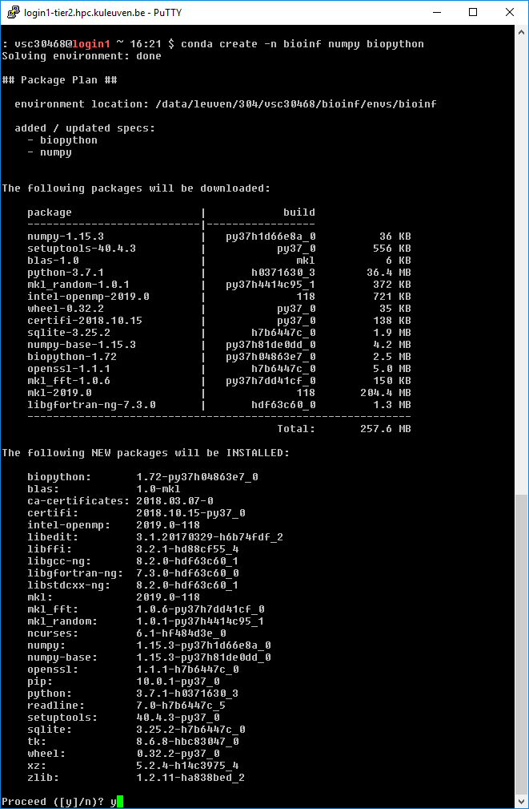
Installing Python packages using conda
Creating an environment
First, ensure that the Miniconda installation is in your PATH environment variable. The following command should return the full path to the conda command:
$ which conda
If the result is blank, or reports that conda can not be found, modify the `PATH` environment variable appropriately by adding miniconda's bin directory to PATH.
Creating a new conda environment is straightforward:
$ conda create -n bioinf numpy biopython
This command creates a new conda environment called science, and installs a number of Python packages.
This will default to the latest Python 3 version, if you need a specific version, e.g., Python 2.7.x, this can be specified as follows:
$ conda create -n bioinf python=2.7 numpy biopython

Slide 151
Installing Python packages using conda
Working with the environment
To work with an environment, you have to activate it. This is done with, e.g.,
$ source activate bioinf
Here, science is the name of the environment you want to work in.
Install an additional package
To install an additional package, e.g., `pandas`, first ensure that the environment you want to work in is activated.
$ source activate bioinf
Next, install the package:
$ conda install pandas
Note that conda will take care of all dependencies, including non-Python libraries. This ensures that you work in a consistent environment.

Slide 152
Installing Python packages using conda
Updating/removing
Using conda, it is easy to keep your packages up-to-date. Updating a single package (and its dependencies) can be done using:
$ conda update biopython
Updating all packages in the environement is trivial:
$ conda update --all
Removing an installed package:
$ conda remove pandas
Deactivating an environment
To deactivate a conda environment, i.e., return the shell to its original state, use the following command
$ source deactivate

Slide 153
Installing Python packages - alternatives
Checking for installed packages
Pip utility will list all packages that are installed for the Python distribution you are using, including those installed by you, i.e., those in your PYTHONPATH environment variable.
Load the module for the Python version you wish to use, e.g.,: $ module load Python/2.7.14-foss-2018a
Run pip: $ pip freeze
Note that some packages, e.g., mpi4py, h5py, pytables, ..., are available through the module system, and have to be loaded separately. These packages will not be listed by pip unless you loaded the corresponding module.
If you have any packages installed in .local directory, it will always take priority on whatever the Python version used (conda, module, system). That can lead to strange problems, so please avoid using that location.

Slide 154
Installing Python packages - pip
Load the appropriate Python module, i.e., the one you want the python package to be available for: $ module load Python/2.7.14-foss-2018a
Create a directory to hold the packages you install, the last three directory names are mandatory: $ mkdir -p "${VSC_DATA}/python_lib/lib/python2.7/site-packages/"
Add that directory to the PYTHONPATH environment variable for the current shell to do the installation: $ export PYTHONPATH="${VSC_DATA}/python_lib/lib/python2.7/site-packages/:${PYTHONPATH}"
Add the following to your .bashrc so that Python knows where to look next time you use it: export PYTHONPATH="${VSC_DATA}/python_lib/lib/python2.7/site-packages/:${PYTHONPATH}"
Install the package, using the prefix install option to specify the install path (this would install the biopython package): $ pip install --user biopython
or
$ pip install --install-option="--prefix=${VSC_DATA}/python_lib" biopython

Slide 155
Installing Python packages – easy_install
Load the appropriate Python module, i.e., the one you want the python package to be available for: $ module load Python/2.7.14-foss-2018a
Create a directory to hold the packages you install, the last three directory names are mandatory: $ mkdir -p "${VSC_HOME}/python_lib/lib/python2.7/site-packages/"
Add that directory to the PYTHONPATH environment variable for the current shell to do the installation: $ export PYTHONPATH="${VSC_HOME}/python_lib/lib/python2.7/site-packages/:${PYTHONPATH}"
Add the following to your .bashrc so that Python knows where to look next time you use it: export PYTHONPATH="${VSC_HOME}/python_lib/lib/python2.7/site-packages/:${PYTHONPATH}"
Install the package, using the prefix option to specify the install path (this would install the sphinx package): $ easy_install --prefix="${VSC_HOME}/python_lib" biopython

Slide 156
Hands-on 3
Install conda environment with the Biopython package in your $VSC_DATA directory
Submit jobscript pythonjob1.pbs to the cluster. Python script checks how many times string ATA occurs in a given dna1.txt file. Check the answer in output file.
Copy the file pythonjob1.pbs to pythonjob2000.pbs and modify it so that:
You will be notified by e-mail when job finishes or aborts
Name of the job is count-string-2000
Instead of Python from 2018a toolchain conda Python is used
First action that the job does is running multiply.sh script
Instead of count_substr1.py count_substr2000.py script is used
The script looks for ATG string instead of ATA
Submit the job and check how many times string ATG occurs in dna2000.txt file.

Slide 157
Installing R packages using conda
Creating an environment
First, ensure that the Miniconda installation is in your PATH environment variable. The following command should return the full path to the conda command:
$ which conda
If the result is blank, or reports that conda can not be found, modify the `PATH` environment variable appropriately by adding iniconda's bin directory to PATH.
Creating a new conda environment is straightforward:
$ conda create -n science -c r r-essentials r-rodbc
This command creates a new conda environment called science, and installs essentials and required packages.

Slide 158
Installing R packages using conda
Working with the environment
To work with an environment, you have to activate it. This is done with, e.g.,
$ source activate science
Here, science is the name of the environment you want to work in.
Install an additional package
To install an additional package, e.g., `r-ggplot2`, first ensure that the environment you want to work in is activated.
$ source activate science
Next, install the package:
$ conda install -c r r-ggplot2
Note that conda will take care of all independencies. This ensures that you work in a consistent environment.

Slide 159
Installing R packages using conda
Updating/removing
Using conda, it is easy to keep your packages up-to-date. Updating a single package (and its dependencies) can be done using:
$ conda update r-rodbc
Updating all packages in the environement is trivial:
$ conda update --all
Removing an installed package:
$ conda remove r-mass
Deactivating an environment
To deactivate a conda environment, i.e., return the shell to its original state, use the following command
$ source deactivate

Slide 160
Installing other R packages using conda
Installing CRAN package:
> install.packages('readr', repos='http://cran.us.r-project.org')
Alternative approach:
$ conda skeleton cran readr
$ conda build r-readr
$ conda install --use-local r-readr
Doing that for the first time you need to install conda-build before:
$ conda install conda-build
Some packages not available in r-essentials are still available on conda channels, in that case, it's simple:
$ conda config --add channels r; conda install r-readxl

Slide 161
Installing other R packages using conda
Installing CRAN package:
$ conda skeleton cran readr
$ conda build r-readr
$ conda install --use-local r-readr
Doing that for the first time you need to install conda-build before:
$ conda install conda-build
Some packages not available in r-essentials are still available on conda channels, in that case, it's simple:
$ conda config --add channels r; conda install r-readxl

Slide 162
Installing R packages – alternatives
Load the appropriate R module, i.e., the one you want the package to be available for: $ module load R/3.5.0-foss-2018a-bare
start R and install the package from there:
> install.packages("DEoptim")
Alternatively you can download the desired package:
$ wget cran.r-project.org/src/contrib/Archive/DEoptim/DEoptim_2.0-0.tar.gz
And Install the package from the command line:
$ R CMD INSTALL DEoptim_2.2-3.tar.gz -l /$VSC_HOME/R/
These packages might depend on the specific R version, so you may need to reinstall them for the other version.

Slide 163

https://docs.vscentrum.be/en/latest/software/python_package_management.html?highlight=iniconda#install-python-packages-using-conda
Conda on wice
Good practice would be 2 separate paths of conda installations for each cluster.
Beginning of the slurm script matters. Use #!/bin/bash –l not #!/bin/bash to load the env properly.
Universal .bashrc
case ${VSC_INSTITUTE_CLUSTER} in
genius)
export PATH="${VSC_DATA}/miniconda3/bin:${PATH}"
;;
wice)
export PATH="${VSC_DATA}/miniconda3-wice/bin:${PATH}"
;;
esac

Slide 164
Worker Framework

Slide 165
Glossary
Serial application: a program that runs a single process, with a single thread. All computations are done sequentially, i.e., one after the other, no explicit parallelism is used.
Multi-core application: a multi-core application uses more than one core of processor during its execution by running multiple threads, also called a shared memory application.
Distributed application: an application that uses multiple compute nodes for its computations, concurrent computations are executed as processes. These processes communicate by exchanging messages, typically implemented by calls to an MPI library. Messages can be used to exchange data and coordinate the execution.

Slide 166
Parallel Computing
Talk to us about worker framework
Serial:
one program, on one core
’Embarrassingly parallel’ problems:
lots of runs of one program, with different parameters
Problems that require ’real’ parallel algorithms
OpenMP
MPI : Message Passing Interface
Lucky you!

Slide 167
Use case: parameter exploration
temperature | pressure | humidity
293.0 | 1.0e05 | 87
… | … | …
313.0 | 1.3e05 | 75
job_001.pbs
#!/bin/bash –l
#PBS –l nodes=1:ppn=1 -l walltime=00:10:00
cd $PBS_O_WORKDIR weather –p 1.0e05 –t 293.0 –h 87
Many single core computations
#!/bin/bash –l
#PBS –l nodes=1:ppn=1 -l walltime=00:10:00
cd $PBS_O_WORKDIR weather –p 1.003e05 –t 293.3 –h 67
job_030.pbs
…
#!/bin/bash –l
#PBS –l nodes=1:ppn=1 -l walltime=00:10:00
cd $PBS_O_WORKDIR weather –p 1.3e05 –t 313.0 –h 75
job_600.pbs
…

Slide 168
Solution: worker with -data
temperature | pressure | humidity
293.0 | 1.0e05 | 87
… | … | …
313.0 | 1.3e05 | 75
data.csv
#!/bin/bash –l
#PBS –l nodes=5:ppn=20 -l walltime=01:20:00
cd $PBS_O_WORKDIR weather –p $pressure –t $temperature –h $humidity
job.pbs
$ module load worker $ wsub –data data.csv –batch job.pbs

Slide 169
Data exploration: steps
Write PBS script with parameters
Create Excel sheet with data
Convert to CSV format
Submit with wsub
walltime is time to complete all work items

Slide 170






worker processing: informally
slave₁
slave queries for work
/
master sends work
/
slave notifies on success/failure, queries
for more work
master
…
Done!
master sends stop
/
slave_{S}
batch.sh.worker

Slide 171
Resuming jobs: wresume
Resuming a job that hit the walltime
Redoing failed work items
$ wresume -l walltime=1:30:00 -jobid 445948
$ wresume -jobid 445948 -retry

Slide 172
How to use worker well?
Many work items, i.e., #work items/#proc >> 1
time(work item) > 1 minute
Work item is not multithreaded
Work item is multithreaded
will work, but user must be careful to request the right resources
Use –threaded <n> flag with wsub
There be dragons: licensing!

Slide 173
worker & conflicts
worker module only required for
job submission, i.e., wsub, wresume
data aggregation, …, e.g., wcat, wreduce, …
No need to load in PBS script
use module purge
minimizes conflicts
work items run in own Bash shell
However, MPI may be problematic
e.g., mpi4py

Slide 174
worker & multithreading
Some software uses multithreading automatically, e.g.,
R
Matlab
Will use as many threads as there are cores, regardless of system load
36 cores/node
36 work items/node
36 × 36 threads/node
Oversubscription: very inefficient!!!

Slide 175
Controlling number of threads
R, most of the time: OMP_NUM_THREADS=1
Matlab
Use maxNumCompThreads(1) function call
Use compiler flag: mcc –singleCompThread …
#!/bin/bash -l
#PBS -N my-pe
#PBS -l walltime=1:00:00,nodes=5:ppn=20
module load R
cd $PBS_O_WORKDIR
export OMP_NUM_THREADS=1
Rscript program $a $b
program_pe.pbs

Slide 176
Help on worker
See documentation http://worker.readthedocs.io/
Each command has help, use -h

Slide 177
Demo: Test for yourself

Slide 178
demo/test yourself
Request membership to lp_hpcintro_training group (account.vscentrum.be)
Login with putty
Filetransfer with Filezilla
Login with NX
Check disk quota
Check the credits
Check/load/list/unload/purge module

Slide 179
demo/test yourself
Copy intro training files (/apps/leuven/training/HPC_intro/) to your $VSC_HOME
Submit cpujob to the cluster
List all your jobs (qstat)
Check the information about the cpujob (checkjob)
Modify the mat.pbs script to request 1 node, 36 cores for 30 minutes and get the notification about job start/end by e-mail
Check the status of all the jobs

Slide 180
demo - monitoring
Submit an interactive job
Run your program on a compute node
Open a new terminal and ssh to a compute node
Check the resources usage (top, htop)

Slide 181
demo – conda installation
Install miniconda in your $VSC_DATA directory
$ wget https://repo.continuum.io/miniconda/Miniconda3-latest-Linux-x86_64.sh
$ bash Miniconda3-latest-Linux-x86_64.sh -b -p $VSC_DATA/miniconda3
Add a PATH to conda:
$ export PATH="${VSC_DATA}/miniconda3/bin:${PATH}"
Check if conda in added to your $PATH ($ which conda)
Add it to $PATH in your .bashrc
$ echo 'export PATH="${VSC_DATA}/miniconda3/bin:${PATH}" ' >> .bashrc

Slide 182
demo – conda usage
Create a conda environment including Jupyter
$ conda create -n science jupyter numpy scipy
Activate this environment
$ source activate science
Add matplotlib package to this environment
$ conda install matplotlib
Return to original environment
$ conda deactivate

Slide 183
demo – notebooks
Start an interactive GPU job
$ qsub –I –l walltime=30:00 –l nodes=1:ppn=9:gpus=1 –l partition=gpu –A default_project
Activate conda environment
$ source activate science
Go to your working directory (you can use $PBS_O_WORKDIR if you qsub from there) Start notebook
$ jupyter notebook --port ${USER:3} --ip $(hostname)
$ jupyter notebook --port 30468 --ip $(hostname)
Open the link in the browser in NX and test your notebook

Slide 184
Submitting worker jobs
From wICE (Interactive) Node
$ module av worker
------------------- /apps/leuven/icelake/2021a/modules/all -------------
worker/1.6.12-foss-2021a
From Genius Login Node
$ module use /apps/leuven/skylake/2021a/modules/all
$ module av worker
------------------ /apps/leuven/skylake/2021a/modules/all -------------
worker/1.6.12-foss-2021a-slurm worker/1.6.12-intel-2021a-slurm
worker/1.6.12-foss-2021a-wice worker/1.6.12-foss-2021a worker/1.6.12-intel-2021a (D)

Slide 185
Submitting worker jobs
All resources have to be specified inside slurm script
wresume does not work yet. Only wsub is so far supported
-master flag does not work yet

Slide 186
Submitting worker jobs
Let us use one of the worker examples: https://github.com/gjbex/worker/tree/development_slurm/examples/bash_example
alp.slurm alpha.csv
#!/bin/bash -l
#SBATCH --nodes=1
#SBATCH --ntasks-per-node 27
#SBATCH --time=00:30:00
#SBATCH -A lpt2_sysadmin
#SBATCH --cluster=wice
cd $SLURM_SUBMIT_DIR
alphabet.sh $letter $counter
letter,counter
a,1
b,2
c,3
d,4
e,5
f,6
....

Slide 187
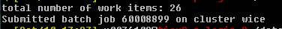
Submitting worker jobs
From Genius
#!/bin/bash -l
module purge
module use /apps/leuven/skylake/2021a/modules/all
module load worker/1.6.12-foss-2021a-wice
wsub -batch alp.slurm -data alpha.csv

Slide 188
Submitting worker jobs
From interactive job on wICE
#!/bin/bash -l
module --force purge
module use /apps/leuven/icelake/2021a/modules/all
module load worker/1.6.12-foss-2021a
wsub -batch alp.slurm -data alpha.csv

Slide 189
demo – worker
Copy intro training files (/apps/leuven/training/worker/) to your $VSC_HOME
Go to exercise1 directory
Submit worker job
Check the output file

Slide 190
VSC
Questions
Helpdesk: hpcinfo@kuleuven.be or https://admin.kuleuven.be/icts/HPCinfo_form/HPC-info-formulier
VSC web site: http://www.vscentrum.be/
VSC documentation: https://docs.vscentrum.be/en/latest/
VSC agenda: training sessions, events
Systems status page: http://status.kuleuven.be/hpc

Slide 192
demo – conda installation
Install miniconda in your $VSC_DATA directory
$ wget https://repo.continuum.io/miniconda/Miniconda3-latest-Linux-x86_64.sh
$ bash Miniconda3-latest-Linux-x86_64.sh –b -p $VSC_DATA/miniconda3
Create an init file (.condainit in $VSC_HOME)
# >>> conda initialize >>>
# !! Contents within this block are managed by 'conda init' !!
__conda_setup="$('/data/leuven/304/vsc30468/miniconda3/bin/conda' 'shell.bash' 'hook' 2> /dev/null)"
if [ $? -eq 0 ]; then
eval "$__conda_setup"
else
if [ -f "/data/leuven/304/vsc30468/miniconda3/etc/profile.d/conda.sh" ]; then
. "/data/leuven/304/vsc30468/miniconda3/etc/profile.d/conda.sh"
else
export PATH="/data/leuven/304/vsc30468/miniconda3/bin:$PATH"
fi
fi
unset __conda_setup
# <<< conda initialize <<<
Initialize conda ($ source $VSC_HOME/.condainit) and check if conda in added to your $PATH ($ which conda)

Slide 193
demo – conda usage
Create a conda environment including Jupyter
$ conda create -n science jupyter numpy scipy
Activate this environment
$ conda activate science
Add matplotlib package to this environment
$ conda install matplotlib
$ conda install -c conda-forge watermark
Return to original environment
$ conda deactivate

Slide 194
demo – notebooks
Start an interactive GPU job
$ qsub –I –l walltime=30:00 –l nodes=1:ppn=9:gpus=1 –l partition=gpu –A default_project
Activate conda environment
$ source activate science
Go to your working directory (you can use $PBS_O_WORKDIR if you qsub from there) Start notebook
$ jupyter notebook --port ${USER:3} --ip $(hostname)
$ jupyter notebook --port 30468 --ip $(hostname) –allow-root
Open the link in the browser in NX and test your notebook

Slide 195
Epilogue

Slide 196
Questions
Helpdesk: hpcinfo@kuleuven.be or https://admin.kuleuven.be/icts/HPCinfo_form/HPC-info-formulier
If you need support: Explain your problem in detail; provide jobID; path to your job scripts
VSC web site: http://www.vscentrum.be/
VSC documentation: https://vlaams-supercomputing-centrum-vscdocumentation.readthedocs-hosted.com/en/latest/ VSC agenda: training sessions, events
Systems status page: http://status.kuleuven.be/hpc https://wwsw.vscentrum.be/en/user-portal/system-status

Slide 197

Hands-on 4
Go to the exercise1 directory (cd $VSC_HOME/HPC_bioinf/exercise1), submit worker job (execute the script) $./worker_alphbet.sh and next analyze the results. How long did it take to run the job?
Add the missing letters of the alphabet and their counter in csv file and resubmit the job. How long did it take to run the job?

